Slide 1


Image Authentication

Slide 2
House of Lords Science and Technology committee 1998
5.5 We recommend that the government encourage the use of authentication techniques. Members of the legal profession should be made aware of the benefits of these techniques, their value in adding weight to evidence and the possible significance of their omission. Further we recommend that the government encourages the adoption of technological measures for the authentication of images as evidence by giving type of approval to them. The Forensic Science service should provide ongoing advice for manufacturers and the users of imaging equipment on authentication technologies.

Slide 3
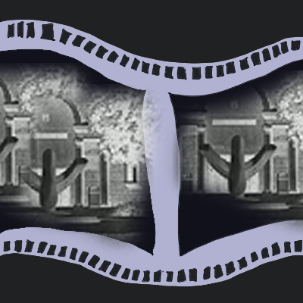

Digital Negative

Slide 4
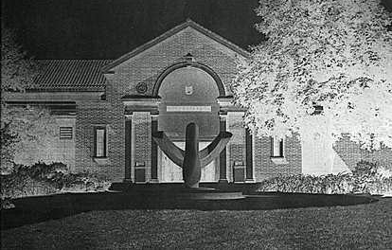
Digital Negative
1001 1001 01001 0110 110011010110100110 110100111 0011000 11111111 10110000 11001100100101100110011001100110011001100011 001010010 11011001101001000010001100101001110010000000000000011111111101010101000000000 11011010 0101101001 011010001000010 11001 0010 1100 110 111 00 1100 111010 10 0111 0011 0001 0011 0001 1000 1100 111 000 110 1100 0000 11 0 1 10 01 01 0 1 10 1 10 1 10 1 1 11 11 1 1 11 1 10 1 0 1 0 1 1 1 111 0 1 00 1 0 1 1 00 11 00110 110110 1100 1100 1100 1111 111 1010 00 1 1 1111 1111 00110 1100110 1110 10 10 1100 11000 111 11111 1111 111 00 110 1100 1100 1000 10 10 10 1 0 10 10 0 11000 1100 1100 110 01100 11 0 0101 11 010 11 1111 1 11 0010 10 1 0 10 110001100 1 110 1 0 1 01 0 1 00 110 1111 11 01 0 1 10 11 0 1 0 1 10 1 101 00 000 11 1 1 0 11 0 11 0 1 00 0 00 0 11 00 1 1 0 11 000 0 111 100 11 00110001 1 00 110 0 11 11 1 10 0 1 1111 11 1111 1 1 0 110 0 11 0 0 1 0 11 0 100 11 0 0 1 1 11 0 00 0 110 0 11111 0 01 0 0 11 1 1 110 1 00 10 0 1010 1 0 10 0 11000 1111 110 11 0 0 1

Slide 5

Images as Numbers
The Digital Image
Conventional photographic film

Slide 6


23
12
252
57
60
100
200
150

Slide 7
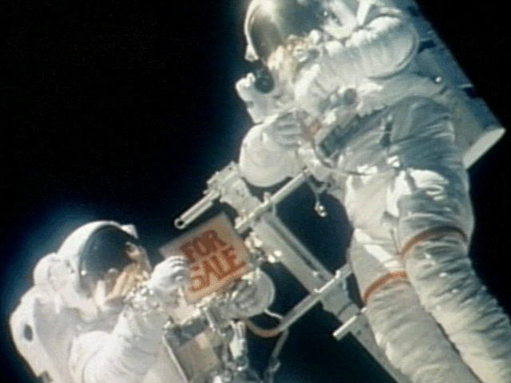
192-bit encryption
10010010010000100100101001010101010101010101010101010101010101001010101010101010101010101010101010010101010101010101010101010101010101010000010000100010010101001010101000
10010010010000100100101001010101010101010101010101010101010101001010101010101010101010101010101010010101010101010101010101010101010101010000010000100010010101001010101000
2
1
4
7
= 2147

Slide 8
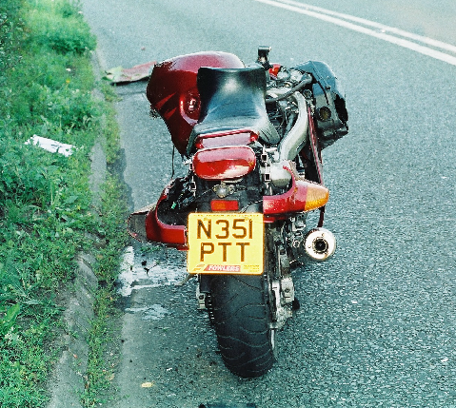
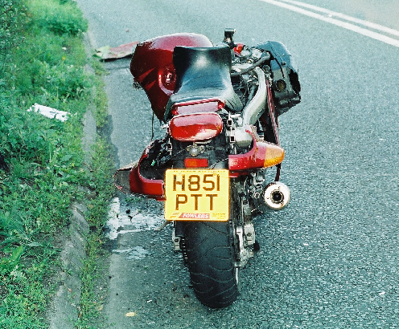
A
B

Slide 9
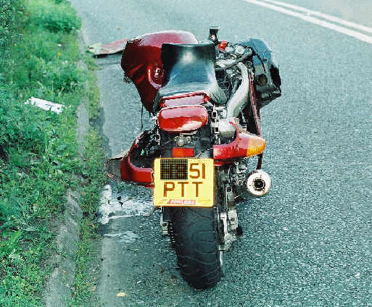
After analysis with Veridata

Slide 10


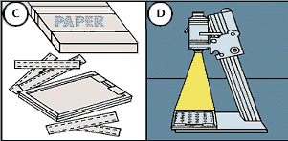

Slide 11
Digital Negative
Working copy
Authenticated with Veridata at the point of image capture. A check-sum number(encrypted to 192 bits) is written into the original image to prevent any image tampering.
Enhanced with digital processing techniques to improve the usefulness of the image.
Stored in any file format and compressed to any ratio. It can be stored with lossy compression algorithms to allow for data transfer from mobile and land based networks.
Bit for bit copy of the original image. The file is saved with lossless coding such as TIFF or BMP.

Slide 12
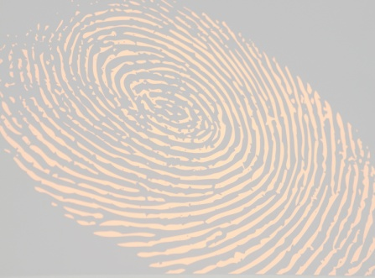
Images and Forensics
Imaging Software based on Scientific Image Enhancement NOT Manipulation
No Colour Palettes, paint brushes, layers etc.
All the processes used can be scientifically explained
All enhanced images are working copies from Authenticated ‘Digital Negatives’ with detailed Forensic Audit Trails

Slide 13
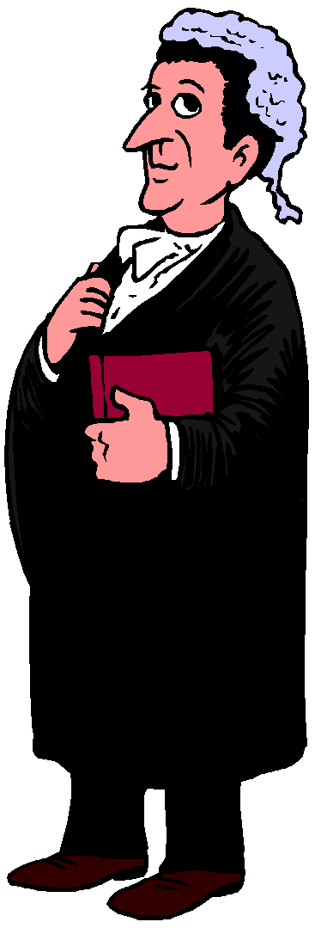
Digital Imaging and the Law
1972
The first known article was published on FFT for image enhancement. It was published by James Roberts, he removed cloth weave from a print. At this time the evidence was not accepted at court.

Slide 14
Digital Imaging and the Law
1990
In march 1990 an unknown assailant sexually molested and fatally stabbed a young women. At the scene the crime investigator recovered a pillowcase upon which there were faint blood stains. This was subsequently submitted to the departments forensic unit for blood stain pattern analysis. The technicians confirmed the following:-
The blood stains were consistent with blood transfer from a knife although no knife was found at the scene.
Also a fingerprint was present which contained enough information for possible identification.
The fingerprint was subsequently treated with DFO to improve the ridge detail. However the fabric weave still prevented the fingerprint being used for identification. All available photographic techniques were used but without success.
Despite the fact that no digitally enhanced images had yet been accepted in court the investigators decided to try. After all they were faced with a no win situation.
The fingerprint was therefore subjected to digital enhancement and within four hours an identifiable print was produced.
During the suppression hearing the defence attorneys launched an attack on the digital techniques and as a result a Frye Hearing was held to determine the admissibility of the evidence.

Slide 15
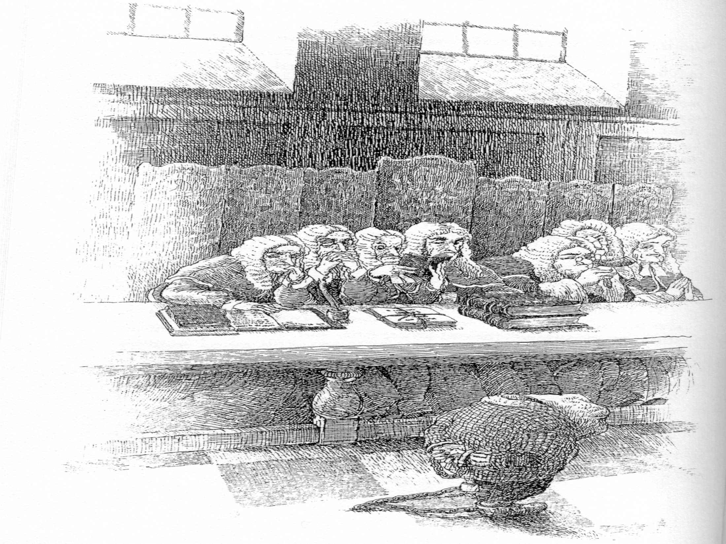
The Frye Hearing
The Test for the Admissibility of a Scientific process within the American courts
1991

Slide 16
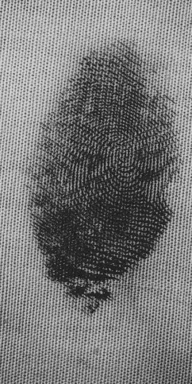
The Frye Hearing
1991

Slide 17
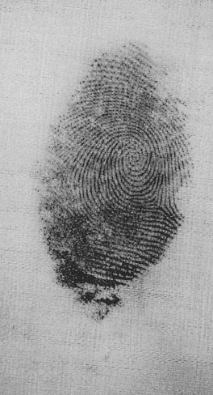
The Frye Hearing
1991

Slide 18
The Frye Hearing
To Counter, an analyst took the court step by step through the entire procedure. An expert in the field of image processing then offered supporting testimony to the court.
Ultimately, the court ruled the print admissible stating that the process did not alter the pattern of the print it only made it more visible.
The evidence passed the test resulting in the first documented case where image enhancement technology passed the challenges of a Frye hearing.

Slide 19
The Frye Hearing
June 18th 1991 the
accused received
four life sentences.

Slide 20
1995
State of Washington v Eric Hayden
Dawn Fehring a 27 year old student was found dead on the floor of her Kirkland apartment on Sunday May 14th 1995.
The police recovered a fitted bed sheet which contained apparent bloody hand prints. The bedsheet was sent to Kirkland police department for examination . Holshue a latent print examiner stained the sheet with Amido black which resulted in further fingerprint detail, however the fabric weave still prevented the marks being used for identification.
Consequently the bed sheet was sent to Erik Berg of the Tacoma police department. He used the Fourier technique to remove the fabric weave. As a result the latent print examiner was able to find 12 points of identification on one of the fingerprints and more than 40 on the palm prints.
A Frye Kelly hearing was requested and eventually rejected after the examiners demonstrated how the enhancements were made to the court.
Hayden was duly convicted of the murder.

Slide 21
Appeal
Filed 17th February 1998
Title of case: State of Washington, Respondent
v
Eric H Hayden, Appellant

Slide 22
Kennedy, AJC __ Eric H Hayden appeals his conviction of felony murder in the first degree, contending that the trial court erred in admitting enhanced fingerprint evidence after conducting a Frye hearing and by ordering him to obtain a mental health evaluation and undergo treatment as a condition of his confinement and placement.2 finding no error, we affirm facts
It is clear even to the untrained eye that the fabric contains a hand print and that nothing appears in the digitally enhanced photograph that was not present in the fabric. Rather the image of the hand print is merely enhanced by removing background detail unrelated to the points of identification by which the hand print was identified as Haydens………….
Accordingly we reject Haydens contention that the court erred by admitting the challenged evidence and affirm his conviction judgement and sentence.

Slide 23
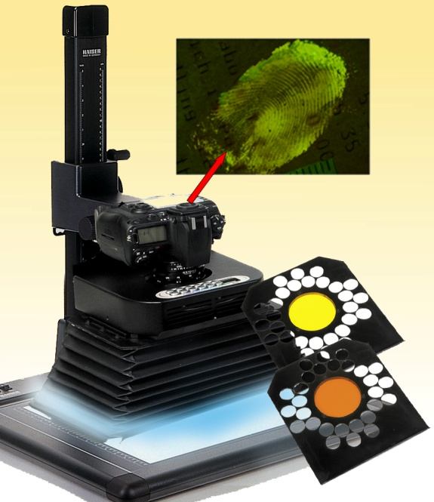
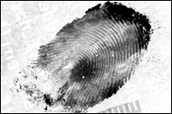
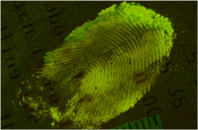
For further information contact
Esther Neate
Esther@Neateimaging.com
http://www.neateimaging.com

