Slide 1
Visible light IMaging
Colour theory and Specialist Lenses

Slide 2
Ultraviolet
365nm
Near Infrared
700-1100nm
Visible 400-700nm
Electromagnetic radiation – connection between light and electromagnetic waves
James Clerk Maxwell 1831 – 79 (physics explained as mathematical equations)
Notes:
Electromagnetic spectrum uv to IR. We are looking at Visible Imaging.

Slide 3
Colour Theory - Additive
R
G
B
Light mixes together in an additive process
Primary colors are red – green – blue
An overlap of RGB yields white or all colors together

Slide 4
Colour Theory - Subtractive
Y
M
C
Colour is created by absorbing wavelengths
When one band is absorbed the remaining bands are combined to create a complimentary (secondary) colour

Slide 5
Colour Theory
R
G
B
Primary colors are
red – green – blue
Secondary colors are
magenta – yellow – cyan
Y
M
C

Slide 6
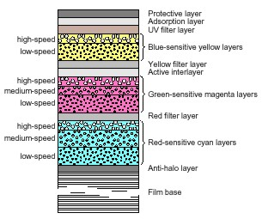
Colour Film – Tri Pack
Each layer contains silver halide crystals and dye couplers. One layer for each of the three secondary colours; yellow, cyan and magenta.
Different films, have different colour representation.

Slide 7
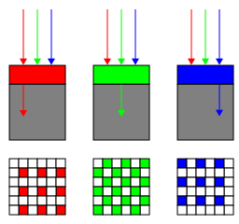
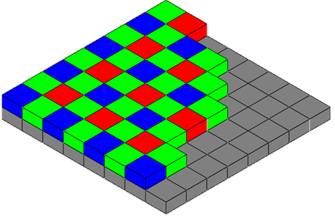
Bayer filtering – the digital image
Incoming Light
Filter Layer
Sensor Array
Resulting Pattern
Filter pattern is 50% G, 25% R and 25% B
Known as BGGR, RGBG, GRGB or RGGB

Slide 8
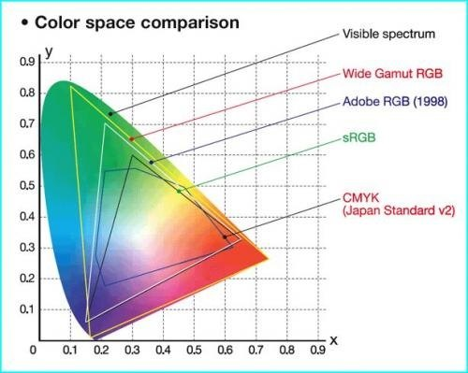
ColoUr space
Set the camera to use Adobe RGB for a wide gamut of colours.
Notes:
Gamut is the effective range of colors in what is referred to as color space. As you can see, Adobe RGB is a wider range of colors than Regular RGB.

Slide 9
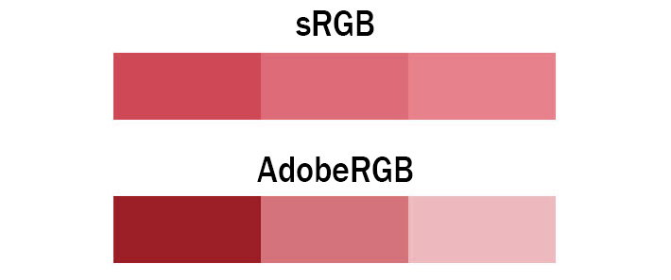
ColoUr space
Both images contain only 3 colours
Colours shown in AdobeRGB have more differential and more vibrant colours
sRGB will ‘dull out’ strong tones
AdobeRGB will display colours with accuracy
Notes:
Gamut is the effective range of colors in what is referred to as color space. As you can see, Adobe RGB is a wider range of colors than Regular RGB.

Slide 10
Colour to Black & white
You say “Black and White”, I say “Grayscale”
The human eye can detect 30 shades of gray
0%
100%
Notes:
You say Black and White. I say Gray Scale. The human eye can only see about 30 shades of gray. The computer however is able to separate many more shades of gray or color depending on the bit depth of the image.

Slide 11
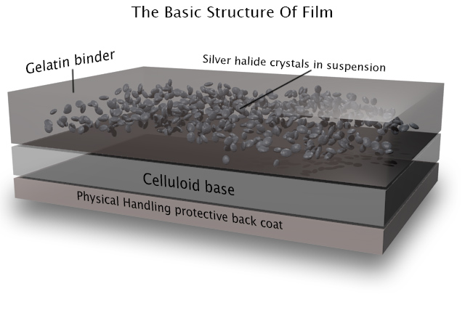
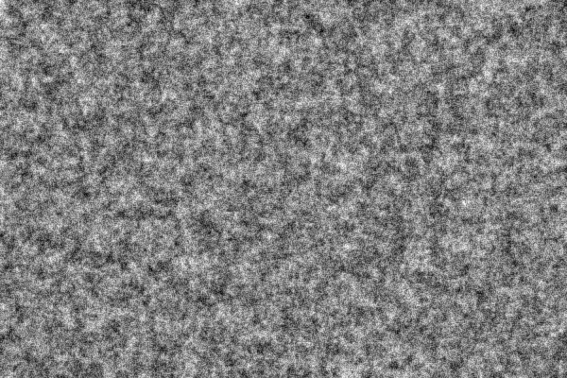


Slide 12
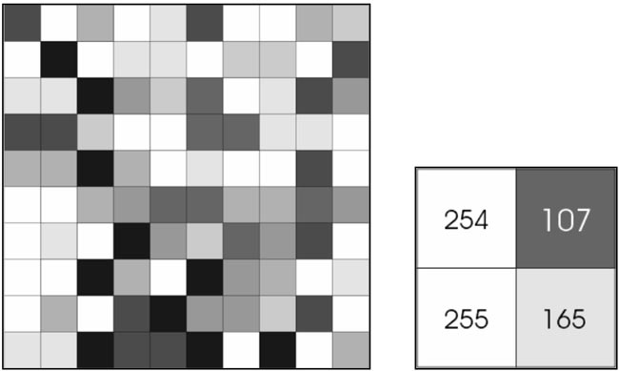
Grey scale image numbers

Slide 13
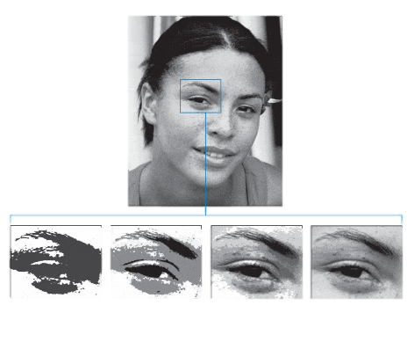
Bit depth = image class
1 bit
2 possible values
2 bit
4 possible values
4 bit
16 possible values
8 bit
256 possible values
Notes:
The greater the bit depth the more the computer has to work with to separate details. Obviously if one has 4096 tones to separate much more information can be derived than from 256. Even though our eyes can only see 30 shades the computer can mathematically separate many times that, convert the image into something we can see thus isolating key pieces of the puzzle allowing many more prints to be resolved. At this point in time most windows programs can not deal with 12 bit imaging, Image-Pro can, and that is the advantage.

Slide 14
Bit depth = image class
8 bit contains values from 0 – 255 - jpg is 8 bit
10 bit contains values from 0 – 1021
12 bit contains values from 0 – 4095 – tif is 12 bit
16 bit contains values from 0 – 65,536
Notes:
The greater the bit depth the more the computer has to work with to separate details. Obviously if one has 4096 tones to separate much more information can be derived than from 256. Even though our eyes can only see 30 shades the computer can mathematically separate many times that, convert the image into something we can see thus isolating key pieces of the puzzle allowing many more fingerprints to be resolved.
If you need to use your 12 bit images in other applications, convert them to 8 bit. Edit convert is the function. DCS can automatically produce 8 bit images each time you sent to output destination, if you so desire.

Slide 15
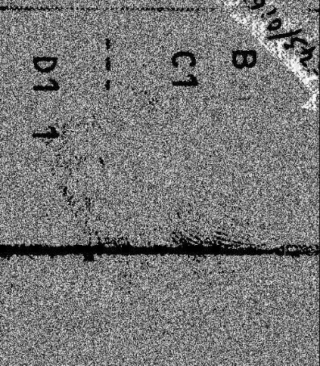
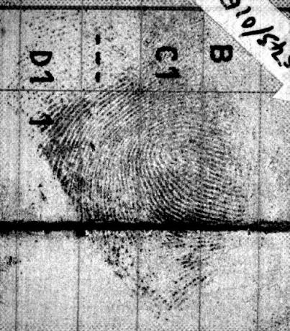
Why use different bit depths
12bit
in 8bit
application
16 bit is the industry standard
8 bit is common in AFIS – many systems now support 12
Fingerprint imaging needs 12 bit data - FFT
Normal
Notes:
If you need to use your 12 bit images in other applications, convert them to 8 bit. Edit convert is the function. DCS can automatically produce 8 bit images each time you print if you so desire.

Slide 16
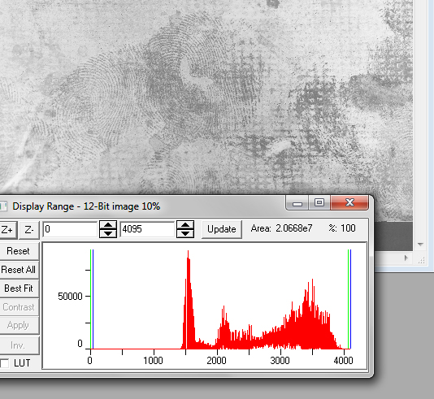
Histogram
show image bit depth
Histogram; a graphic distribution of the tones or frequencies in your image.
Black on the left and White on the right
Adjust your images at the end of processing, not the beginning
Notes:
A histogram is a graphic distribution of all of the tones or frequencies in your image. Black is at the left and White to the far right. Demo the histogram in the software.

Slide 17
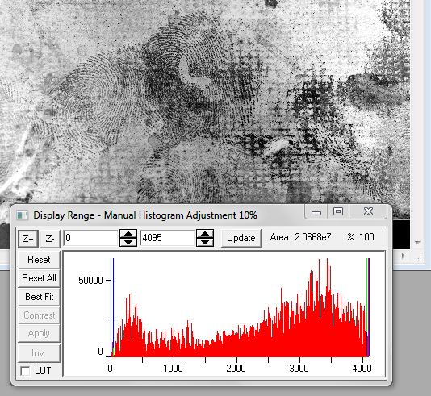
Histogram
show image bit depth
After adjustment 4096 grayscale values are being used
Notes:
Simplest enhancement is to adjust your hisogram.

Slide 18
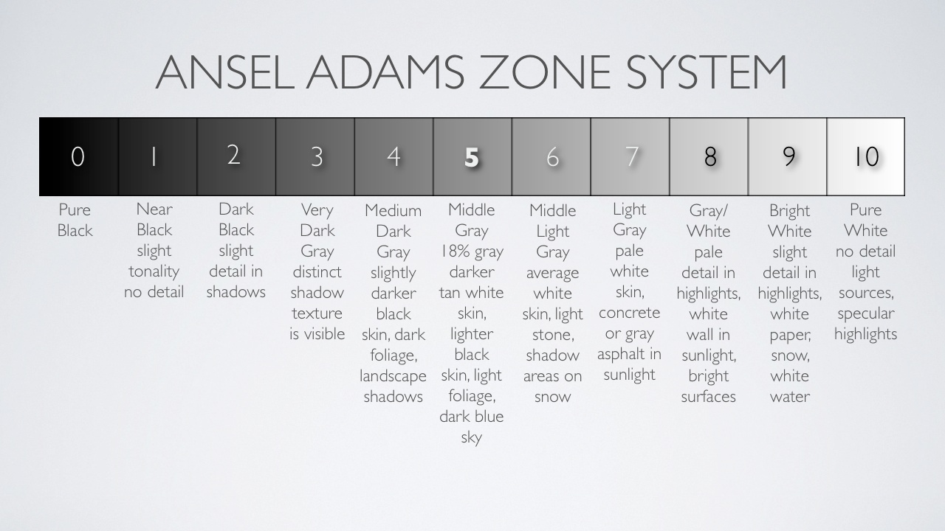
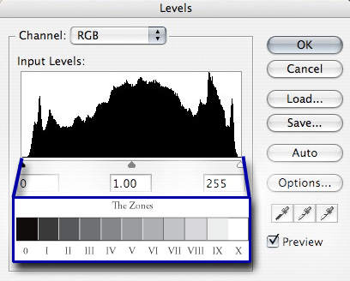
Zone System

Slide 19
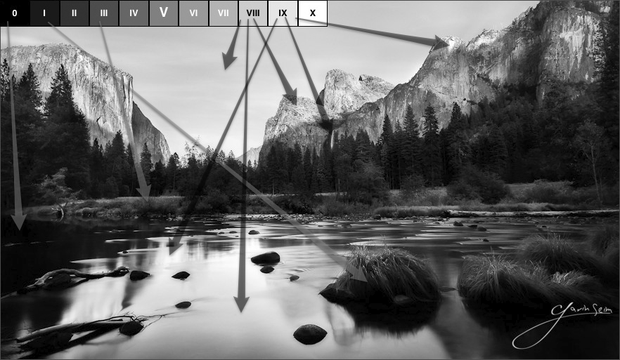
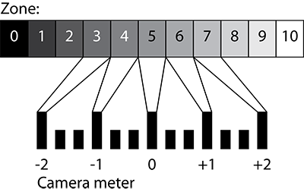
Zone System - exposure

Slide 20
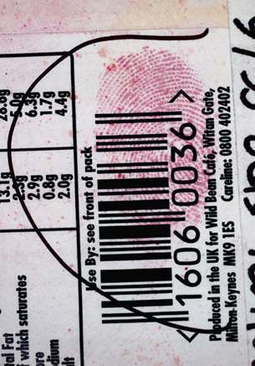
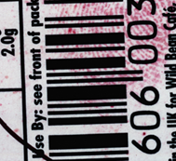
Very dark areas contain NO detail.
Digital can not enhance information that doesn’t exist

Slide 21
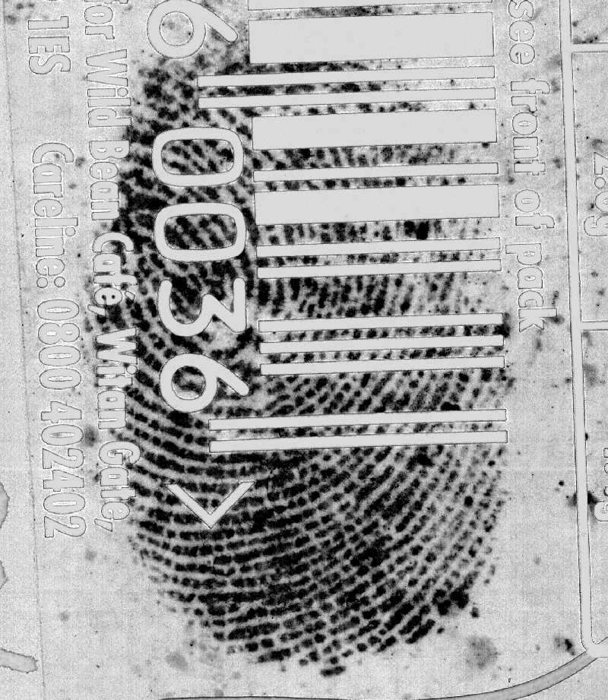
Very dark areas contain NO detail.
Digital can not enhance information that doesn’t exist

Slide 22
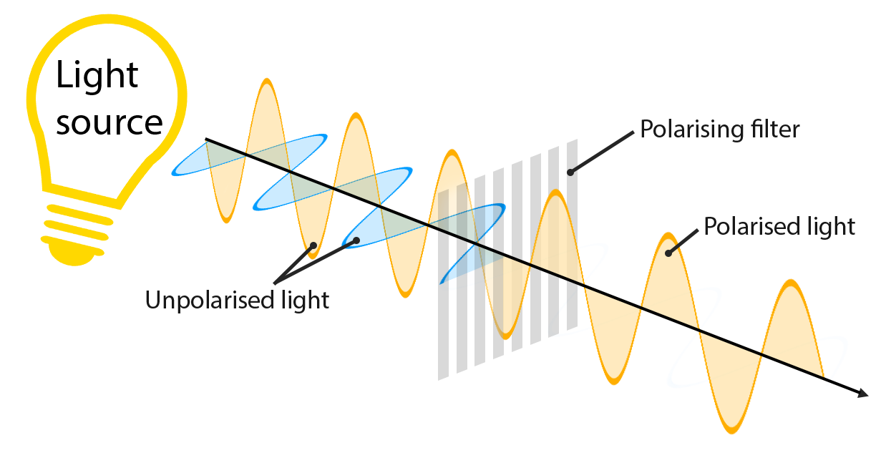
Polarising filters
A light wave that is vibrating in more than one plane is referred to as unpolarised light. ... Polarized light waves are light waves in which the vibrations occur in a single plane. The process of transforming unpolarised light into polarized light is known as polarization.

Slide 23
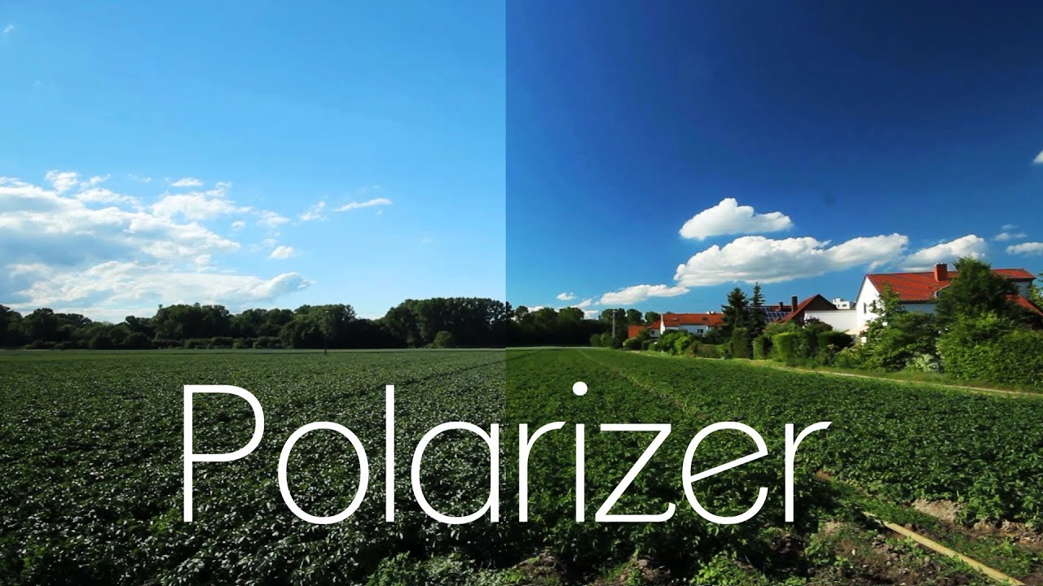

Slide 24
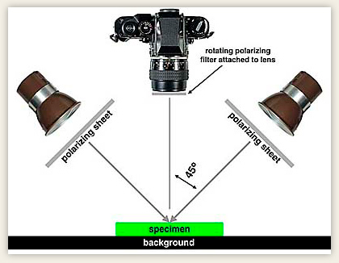
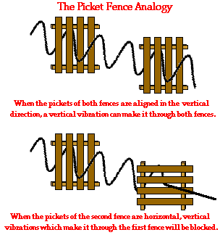
polarising

Slide 25
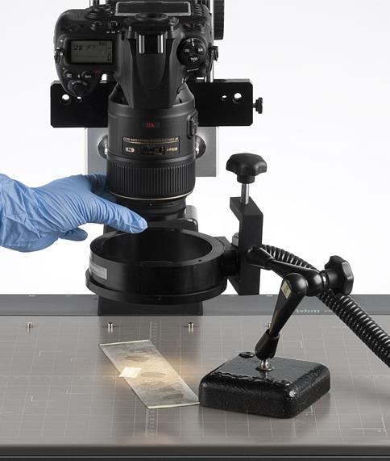
Polarising filters
Polarise the light
Attach a filter to the camera lens
Notes:
Demo some polarizing samples, show the ring light and the goosenecks. Especially curved surfaces.

Slide 26
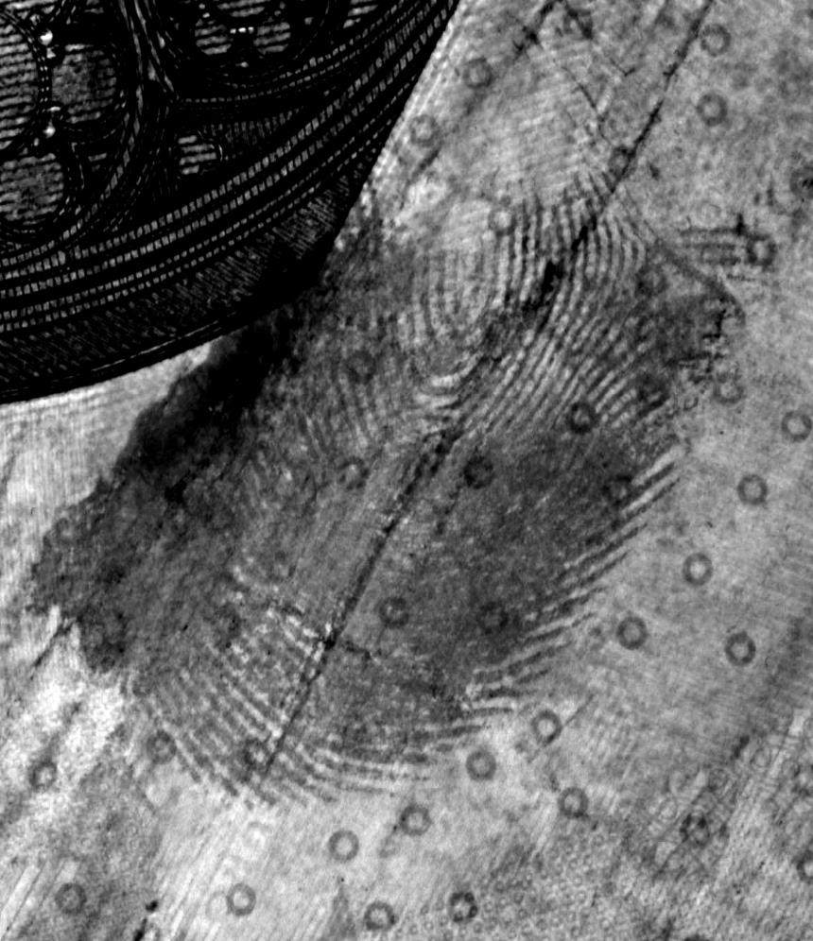
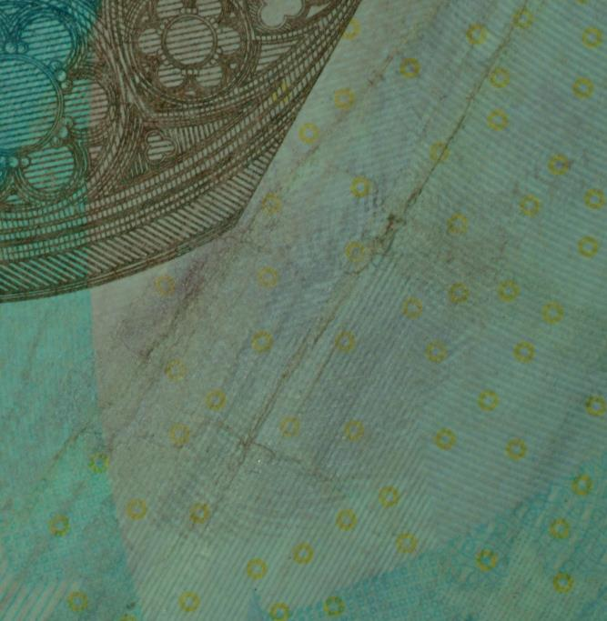
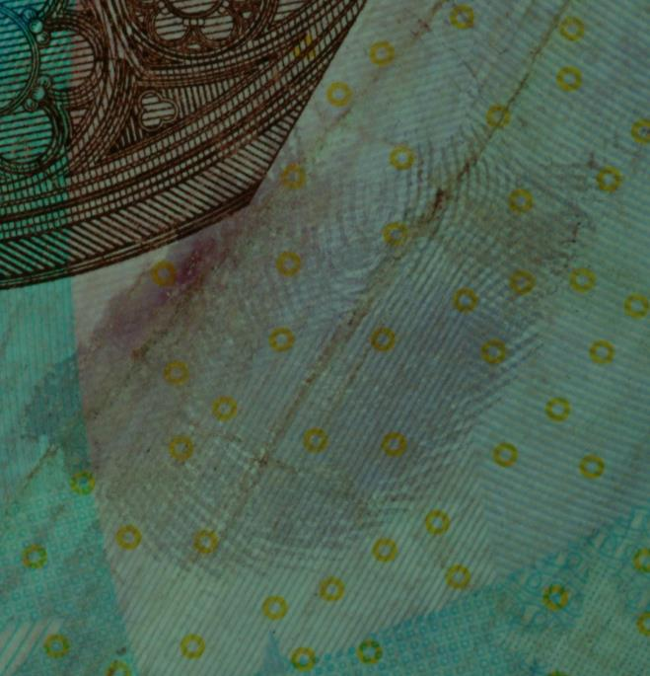
Colour saturation
Original Image
Polarising Filters
Polarise + Digital
Notes:
Removes glare, saturates colours

Slide 27
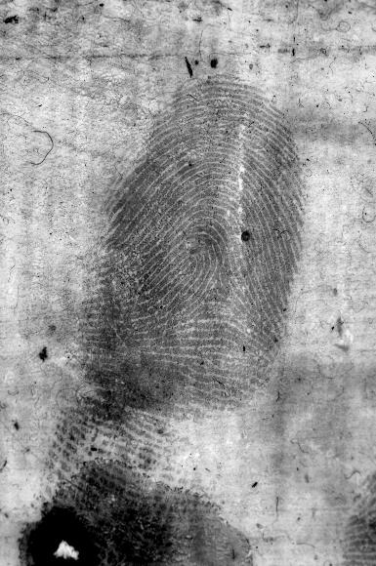
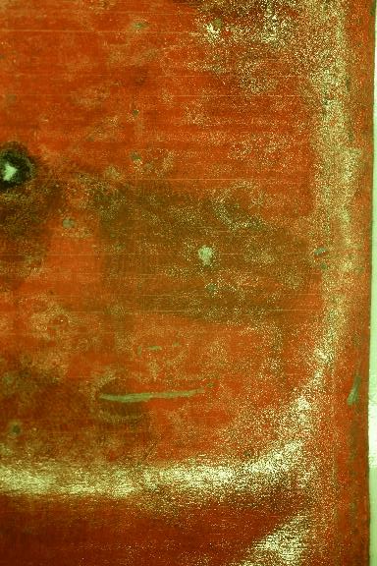
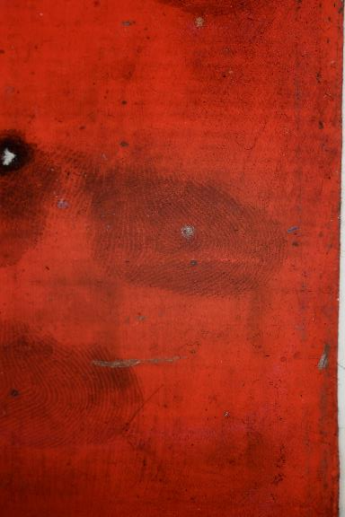
Removing glare
Direct Illumination
Ringlight Illumination
DCS Enhancement
Notes:
Demo sticky tape, fabric, mobile phone latent print. Textured surface. Brown paper, human skin. Demo with hard polarizing and show how it effects exposure.
Demo with goosenecks on cylindrical object, use red bull can, and anything else. show mixing with coloured filters.

Slide 28
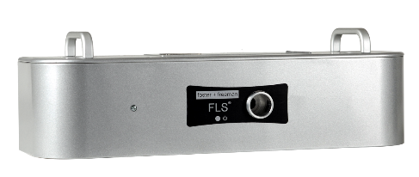
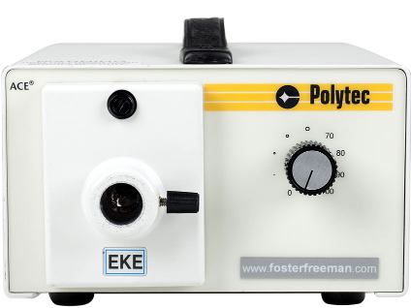
Forensic Light Source (FLS)
Continuous 400-1000nm bandpass filtered illumination.
Halogen Light Source (Polytec)
Intense 150W illumination
Sources of illumination
Notes:
Both Light sources are tungsten, producing a yellow color. Hence the use of filters for ‘white light’. Does white light exist? Both light sources use halogen bulbs, the fls is 100w, the polytec 150w. Both use the same light guides.
Different light guides on different surfaces, introduce the wizard.

Slide 29
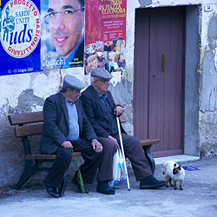
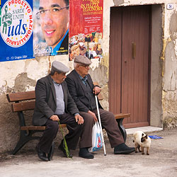
Understanding
white balance
White balance (WB) is the process of removing unrealistic colour casts, so that objects which appear white in person are rendered white in your photo.
Correcting in camera/software – effects the captured data only, change the colour of your light first
Notes:
If you are shooting RAW images white balance has no effect as you correct color balance in your computer when you process the RAW files.
Demo the colour balance settings in the software on both light sources. Yellow filter on the Polytec. White on the FLS. New dcs5 colour balance.

Slide 30
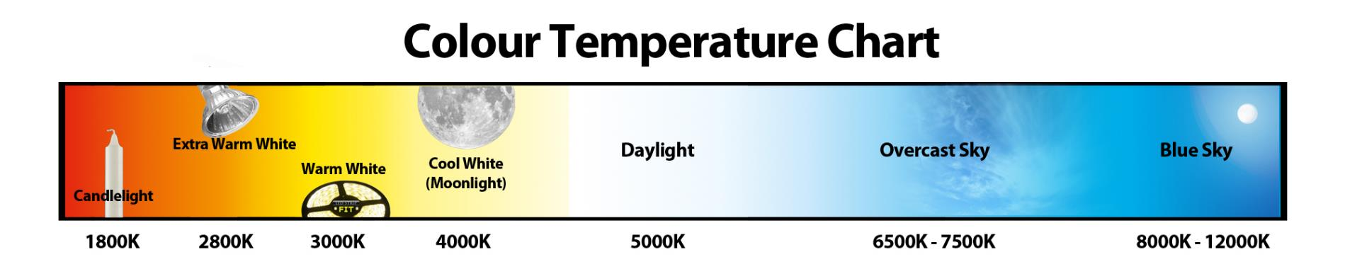
Understanding
white balance
Notes:
If you are shooting RAW images white balance has no effect as you correct color balance in your computer when you process the RAW files.

Slide 31
Workflow
Samples
Single colour – use same or opposite colour to increase contrast
Yellow, orange or red to increase contrast on same colour background – consider contrast in fingerprint.
‘White light’ should be DAYLIGHT balanced
Notes:
Demo ninhydrin, green filter. Demo latent print on drinks glass with green filter using the goosenecks. Try red and green.

Slide 32
Angles of Light
Textured surfaces, light from above with standard Ring Light – reduces texture – Ninhydrin.
Raised fingerprints on smooth surfaces – use Darkfield Ring light - light from the sides
Curved surfaces, light from the sides with goosenecks.
Coaxial light on difficult to see surfaces
Notes:
Demo texture in the surface with brown cardboard. Demo 3d sample, and a finger, with enhancements. All paper is a textures surface, use soft light from above to flatten he surface reducing texture.
Show Wizard.
Show coaxial, cd, mirrors, smooth card with superglue etc

Slide 33
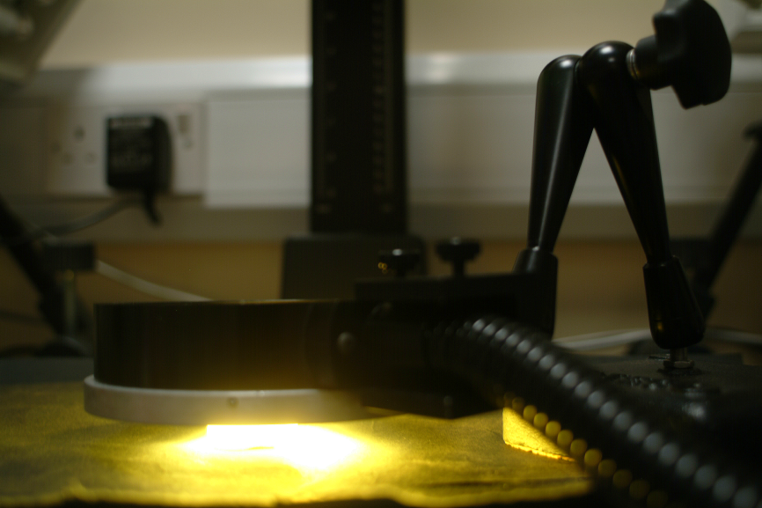
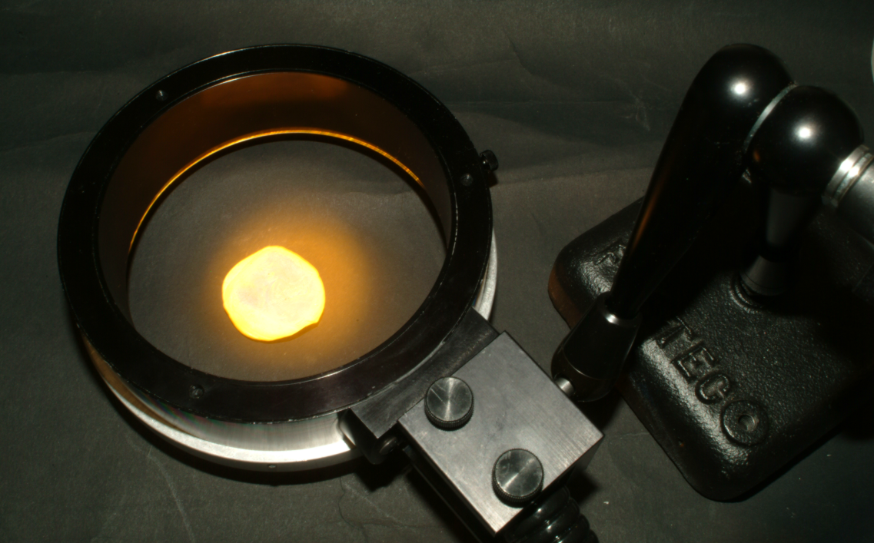
Dark Field Ring light
Show detail by creating shadows
Dark-field Ring-light

Slide 34
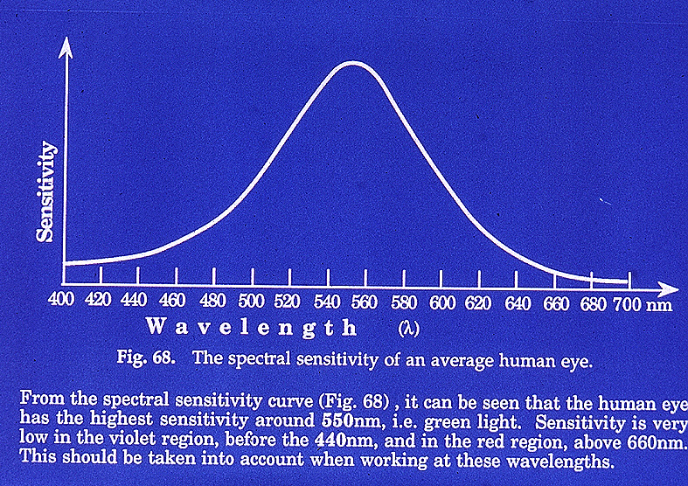
Blood 416nm absorption
Notes:
Side lighting to highlight blood, demo blood sample on the fls.

Slide 35
Blood Blue Filters
Notes:
Adding a blue filter o the light source, has this effect in color

Slide 36
Blood Blue Filters
Notes:
Adding a yellow filter has this effect in color

Slide 37
Notes:
Demo blood on the fls

Slide 38
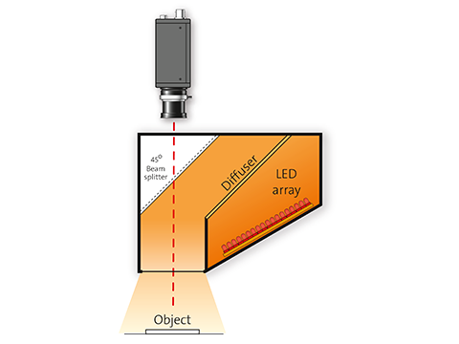
Coaxial Light
A beam splitter or a semi-transparent mirror is used to divert the light from a light source that is fixed on the side (coaxial), so that it is projected almost parallel to the optical axes of the camera onto the object.
Notes:
Demo new coaxial lighting, show that it is very easy.

Slide 39
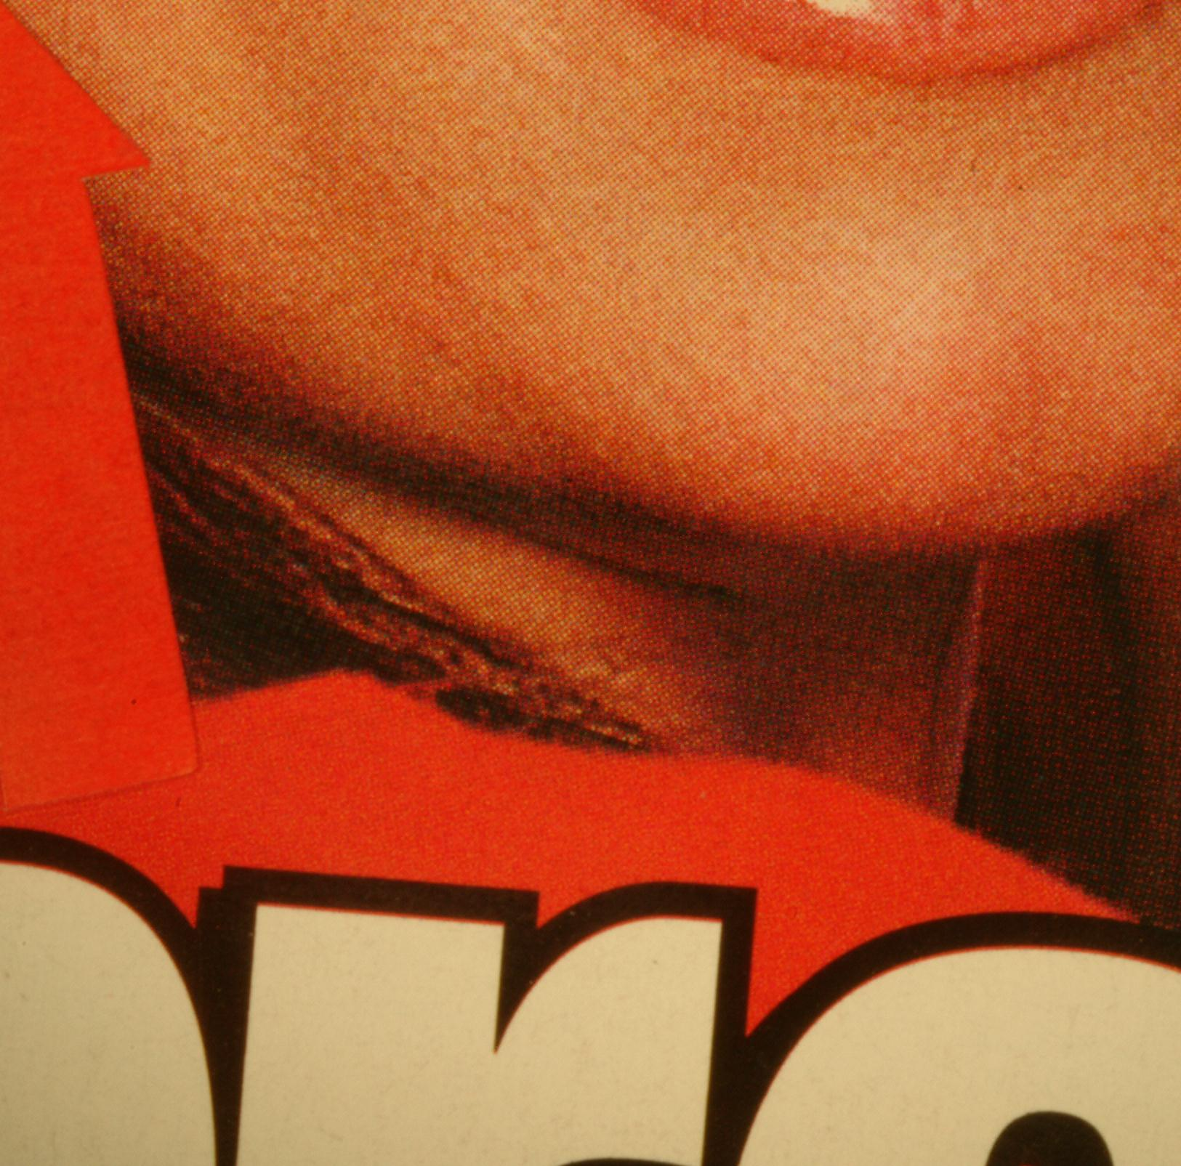

Coaxial Light

Slide 40
Which colour filters?
Filter Wheel - Visible Imaging
Notes:
Colour Filters for the basis of all visible imaging

Slide 41
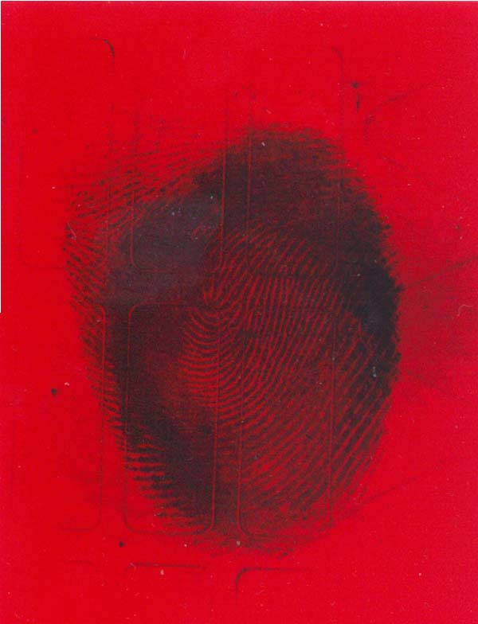

Slide 42
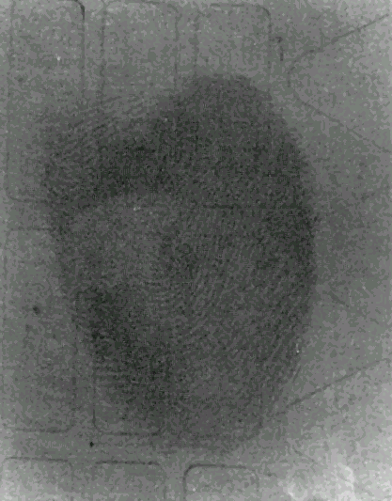

Slide 43
colour filters
R
C
G
M
B
Y
Remove it 'self darken the Opposite colour
Notes:
Primary and secondary colours

Slide 44


From a to b
R
G
B

Slide 45
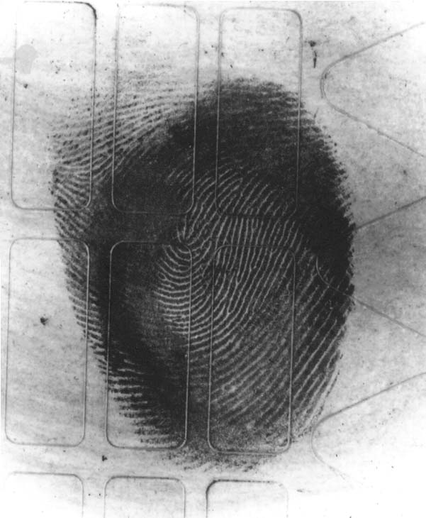

Slide 46
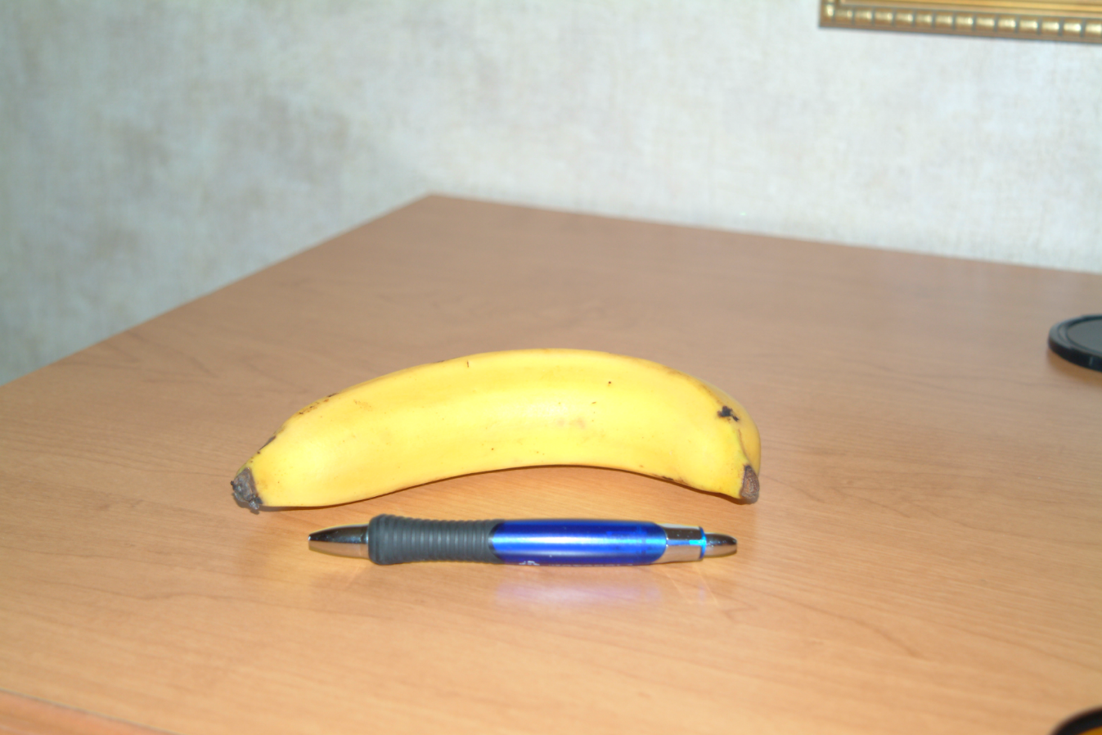
Notes:
This series of photos is an example if using a color filter to de-emphasis parts of a photo.

Slide 47
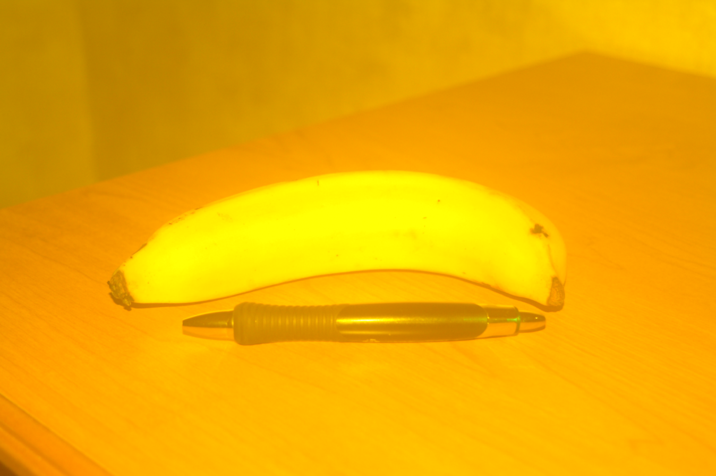
Notes:
Adding a yellow filter has this effect in color

Slide 48
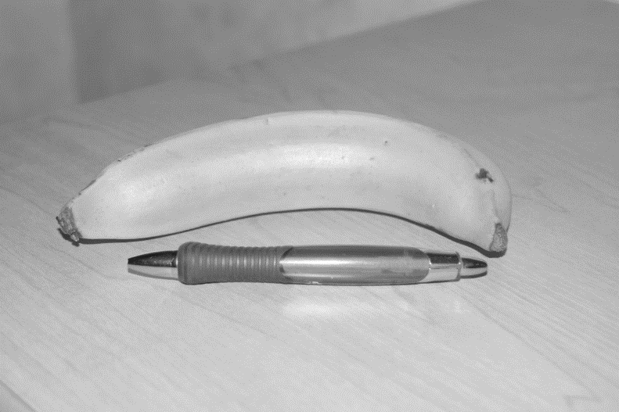
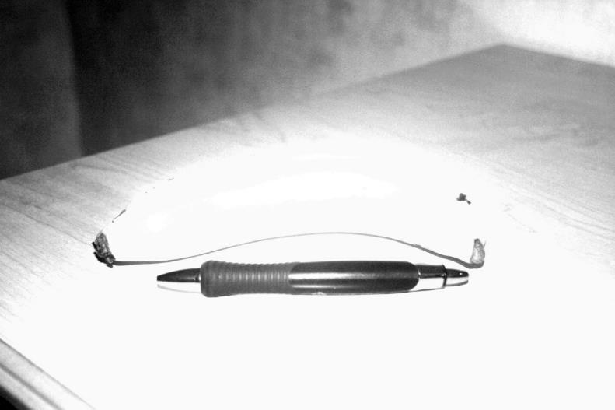
Colour Filter - Yellow
Daylight
Yellow Filter
Notes:
Converted to black and white the yellow banana and light brown table nearly disappear. The blue pen stands out a bit more.
Demo ninhydrin sample with colour filters, nin on red, show with green and with red, show the difference. Explain single colour use colour filter. Then look at multiple colours.

Slide 49
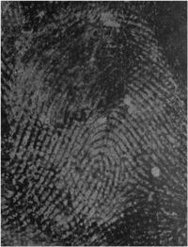
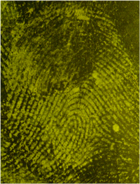


THREE FILTERS TO INCREASE CONTRAST
Yellow x1 Orange x2 Red x3
Notes:
Adding a yellow filter has this effect in color – Explain increasing contrast. 3d fingerprint sample.

Slide 50


Background removal – Multiple Colours – Light + Digital
Notes:
Demo live samples, show exposure, polarising filter control.

Slide 51
From a to b
R
G
B
Notes:
Single Colour removed or amplification, use a colour filter to remove or increase a wavelength of light.

Slide 52

From a Daylight to b
R
G
B

Slide 53

Original
Notes:
Show colour channel separation

Slide 54
Colour modelling
An abstract mathematical model describing the way colours can be represented as tuples of numbers, typically as three or four values or colour components. When this model is associated with a precise description of how the components are to be interpreted (viewing conditions, etc.), the resulting set of colours is called colour space. This section describes ways in which human colour vision can be modelled.

Slide 55

hsl
hsv

Slide 56





RGB YIQ HSI HSV
Notes:
There are four primary color models used to interpret colors. Like dividing the image into several shades of gray, different color models can be utilized to extract data from your image. Notice how different portions of the image look much different depending on the color model employed. Some channels also look exactly the same.

Slide 57

Rgb daylight filter
To capture ‘all’ possible color information we use a daylight filter

Slide 58



rgb
red
green
blue

Slide 59



HSV
hue
saturation
value

Slide 60

hsi
hue
saturation
intensity

Slide 61



YIQ
Y- luminance
i- phase
Q- quadrature

Slide 62

Uk £ quad
Original
Quad
Notes:
Demo to show how easy this process is in the toolboxes.

Slide 63
Background removal
Very dark areas contain NO detail.
Digital can not enhance information
that doesn’t exist
Notes:
What effects how these filters work

Slide 64

Very dark areas contain NO detail.
Digital can not enhance information
that doesn’t exist
Notes:
Demo live samples, show exposure, polarising filter control and how it effects the banknotes tools images.

Slide 65

Zone system

Slide 66
Zone system - exposure

Slide 67

Aperture | depth of field | diffraction
f/1.8
f/2.8
f/4.0
f/8
f/11
f/22
Notes:
Common problems with low cost lenses, high quality optics are essential.

Slide 68





Aperture
f/1.8
f/2.8
f/4.0
f/8
f/11
f/22
Lets in
more
light
Lets in
Less
light
Large Aperture
Medium Aperture
Small Aperture
Shallow D.o.F
Depth of Field
Greatest D.o.F
Notes:
Common problems with low cost lenses, high quality optics are essential.

Slide 69
What aperture should I use

Slide 70

sensors
Fingerprints require a minimum sensor size of APS-c, Full frame 35mm or medium format.
All have advantages and disadvantages
Smaller sensors are not recommended

Slide 71
Sensor size comparison
35.80mm
23.60mm
15.70mm
23.90mm
APS-C
16.0MP CMOS
Nikon D7000
Full Frame
21.0MP CMOS
Nikon D5

Slide 72
Pixel pitch
Sensor Size 1/ 2.3”
Sensor Size 1/ 1.7”
1.55µ
pixel
1.85µ
pixel

Slide 73


Pixel pitch
DSC-R1
21.5 x 14.4mm CMOS
DSC-F828
8.8 x 6.6mm CCD
Image Noise
Lens Diffraction
PIXEL RAIN
Small Pixel
Med. Pixel
Large Pixel

Slide 74


noise
High ISO performance is limited by the size of the pixel pitch and the camera electronics ability to control dark current noise

Slide 75


Signal to noise
The top above has a sufficiently high SNR to clearly separate the image information from background noise.

Slide 76
Signal to noise
A low SNR would produce an image where the "signal" and noise are more comparable and thus harder to discern from one another.

Slide 77
ISO & image noise
It is nearly impossible to increase film speed without increasing noise.
Speed can only come at the expense of reducing the pixel count by making each one bigger.
Or at the expense of dynamic range compared to what is expected of quality photography in colour.
Small pixels = low signal, high noise at high ISO settings.
Larger pixels = high signal, use higher ISO with low noise.
Notes:
Show iso in the software

Slide 78

In camera noise reduction
Noise can be reduced at the expense of resolution by averaging over adjacent pixels. Most cameras and essentially all computer software reduces noise by losing information.
Don’t use High NR settings for fingerprints, it will eliminate fine detail

Slide 79
Live Images – noise 815nm D810

Slide 80

Live Images – noise 815nm D5

Slide 81

Live Images – noise 859nm D810

Slide 82

Live Images – noise 859nm D5

Slide 83
Sensor comparisons
Camera Megapixels Pixel Pitch
in microns
Pentax 645D 40.4 6.0
Nikon D800 36.3 4.88
Nikon D810 36.30 4.87
NIKON d850 45.7 4.34
Nikon D5 20.8 6.45
Nikon D4 16.2 7.3
Nikon D3/s 12.1 8.46
Nikon D3x 24.4 5.95
Canon 1Ds Mk III 21.1 6.4
Canon 5DIII 22.3 6.4
Canon 5D Mk II 21.1 6.4
Canon 1D Mk IV 16.1 5.7
Nikon D7000 16.2 4.8
Canon 7D 17.9 4.3

Slide 84


LENS diffraction F-Stop
Large
Opening
When photographers talk about lens diffraction, they are referring to the fact that a photograph grows progressively less sharp at small aperture values – f/16, f/22, and so on. As you stop down your lens to small apertures, the depth of field will increase, but fine detail in your photographs will begin to blur.
Small
Opening
Notes:
Common problems with low cost lenses, high quality optics are essential.

Slide 85
Diffraction & Pixel pitch
f/4
f/5.6
f/8
f/11
Resolution is limited by the wave phenomenon of diffraction: the current generation of full-frame sensors begin to be diffraction-limited at about f/10 and above, and the best APS sensors at about f/7.
Higher apertures will not increase sharpness above the sensor limit.
More pixels can only improve resolution and contrast at wider apertures.
Notes:
Common problems with low cost lenses, high quality optics are essential.

Slide 86





LENSES
Notes:
Common problems with low cost lenses, high quality optics are essential.

Slide 87


FOCAL LENGTH COMPARISONS
AND IMAGE DISTORTION
Object
a/2
d
F
S₁
S₂
Notes:
Common problems with low cost lenses, high quality optics are essential.

Slide 88


Fast, high quality lenses
for Dcs 5
Lens that perform well at wide apertures
D810 max recommended Aperture F8
D5 Max recommended aperture F16
Recommended Lens
Standard Nikon Macro
Coastal Optics Quartz – UV-IR-Vis
Shift and Tilt
Notes:
Common problems with low cost lenses, high quality optics are essential.

Slide 89

Why use specialist lenses?
Shift & tilt
Notes:
Common problems with low cost lenses, high quality optics are essential. Demo specular light samples, coated paper, smooth and not smooth.

Slide 90


Standard Lens
Shift & Tilt

Slide 91
Image Plane
Lens Plane
Subject Plane
Scheimpflug Intersection

Slide 92


Slide 93



No Tilt
Scheimpflug
Anti-Scheimpflug

Slide 94


No Tilt
Shift & Tilt
Notes:
Demo specular light with the light paddle,

Slide 95


No Tilt
Shift & Tilt

Slide 96
Shift & tilt
Wide aperture with big depth of field. F4, F5.6
Eliminates Lens Diffraction.
Gives sharp images on curved and angled surfaces.

Slide 97
Lighting techniques
Coaxial Illumination – Smooth surfaces – mirrors – cd’s
Specular Illumination – rough surfaces – light paddle
Back light using the baseboard - bottles
Cloudy Day – curved reflective surfaces
Goosenecks with polarised light
Darkfield ring light – fingers – blood
Darkfield light – clear plastic
Notes:
Demo samples

Slide 98

Cloudy day
Uneven reflective surfaces

Slide 99


Notes:
Adding a yellow filter has this effect in color

Slide 100


Notes:
Adding a yellow filter has this effect in color

Slide 101
Multi-coloured
backgrounds

Slide 102
Colour models and
Background subtraction

Slide 103



Slide 104


Notes:
Demo samples, red backgrounds and others.

Slide 105
If colour filters are used to photograph an image,
the other wavelengths are removed.
Colour separation requires the use of a daylight balanced light source
Decide BEFORE you photograph if
the image requires a colour filter, OR
Digital Enhancement.
Notes:
So we have learned that if color filters are used to photograph an image, the other wavelengths are removed. But when using color models for fingerprints you
MUST have all three RGB color channels available. Decide BEFORE you photograph if the image requires a color filter, OR Digital Enhancement.

Slide 106
foster+freeman
Improving the Quality of Forensic Evidence
Recognised for innovation in the field of fingerprint detection & enhancement...

