Slide 1
Light & the Digital Image
Fourier Transform in Forensic Imaging

Slide 2
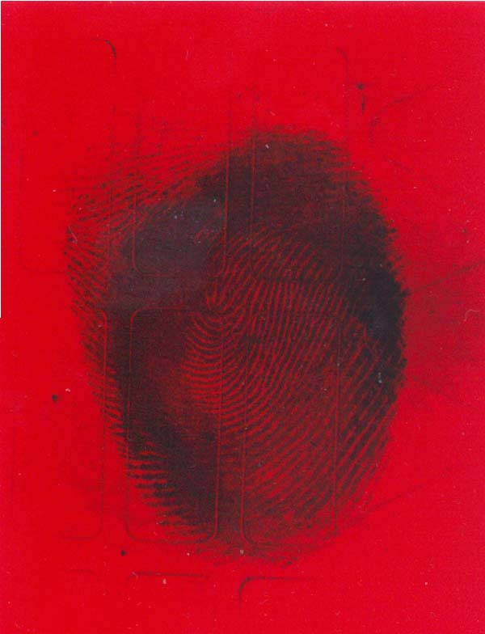
Notes:
Electromagnetic spectrum uv to IR

Slide 3
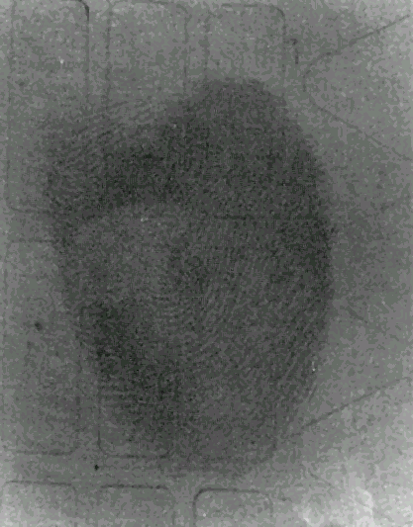
Notes:
Electromagnetic spectrum uv to IR

Slide 4


From a to b
R
G
B
Notes:
Electromagnetic spectrum uv to IR

Slide 5
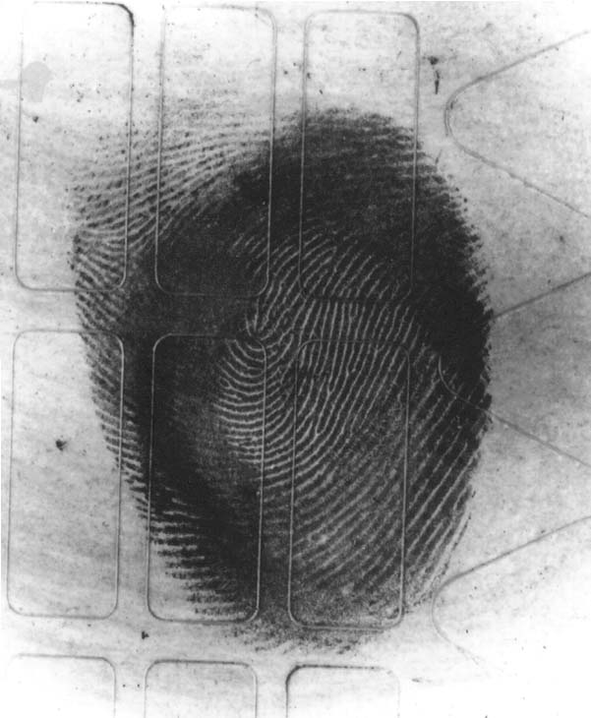
Notes:
Electromagnetic spectrum uv to IR

Slide 6
The Fourier Transform in Forensic Imaging

Slide 7
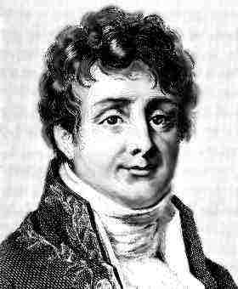
Jean fourier 1768-1830
The Fourier Principle
Any infinitely periodic profile can be analyzed into (or synthesized from) a harmonic series of sinusoidal curves of appropriate amplitude.

Slide 8
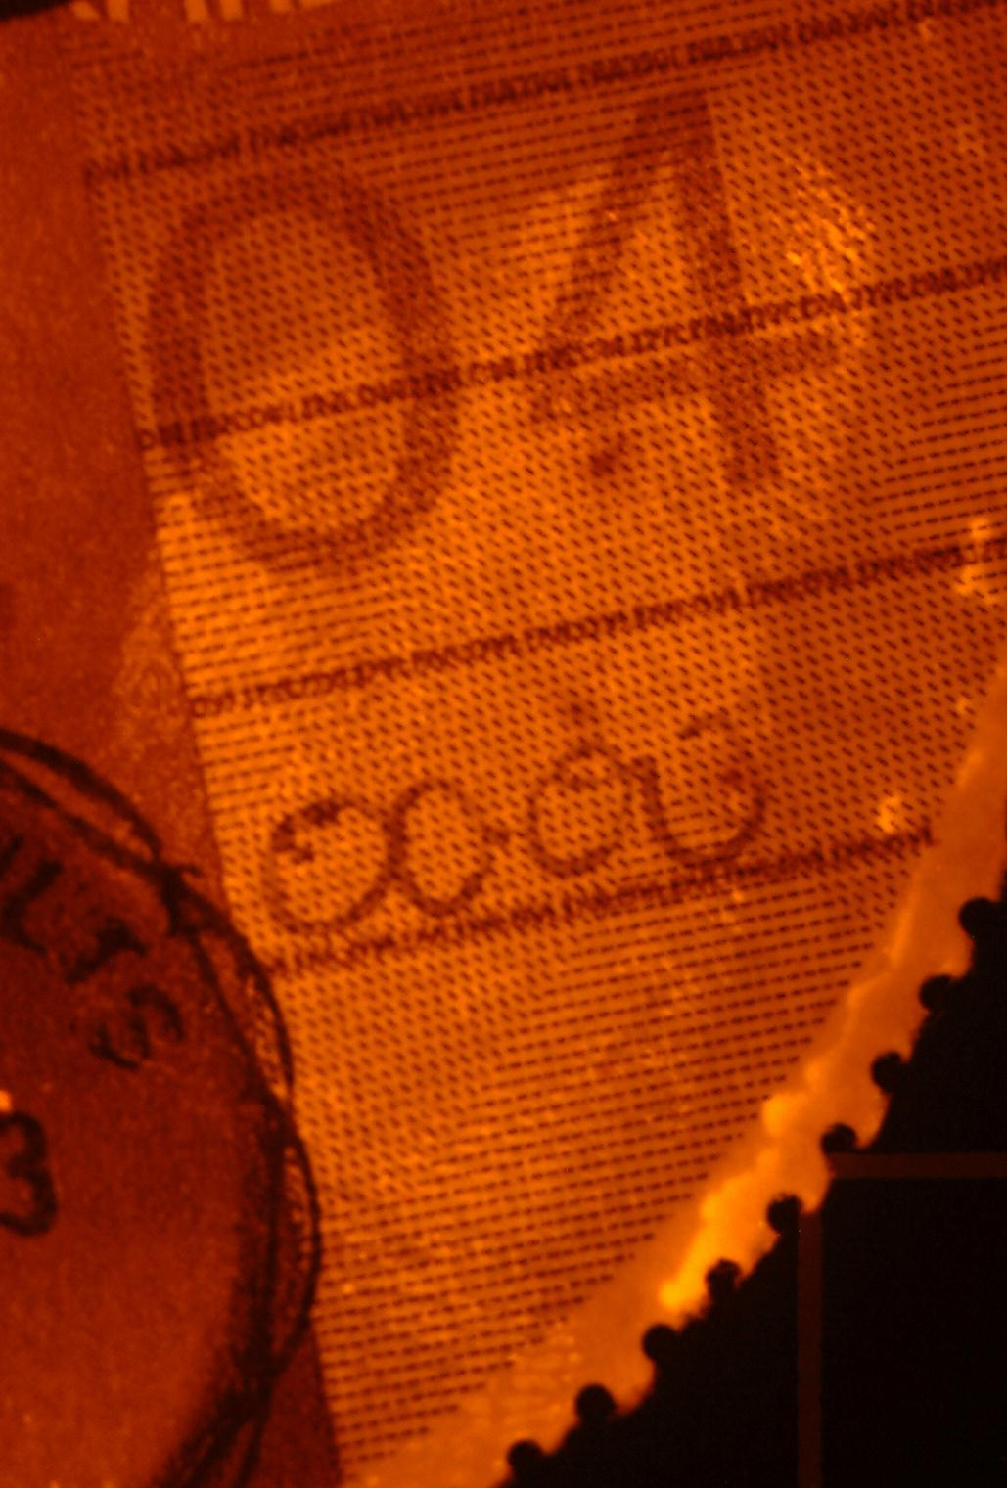
Frequency Separation
DFO

Slide 9
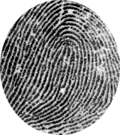
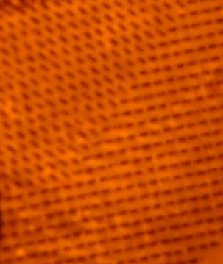
Wavelength
λ
Fingerprint
Wavelength
λ
Background

Slide 10
FFT

Slide 11
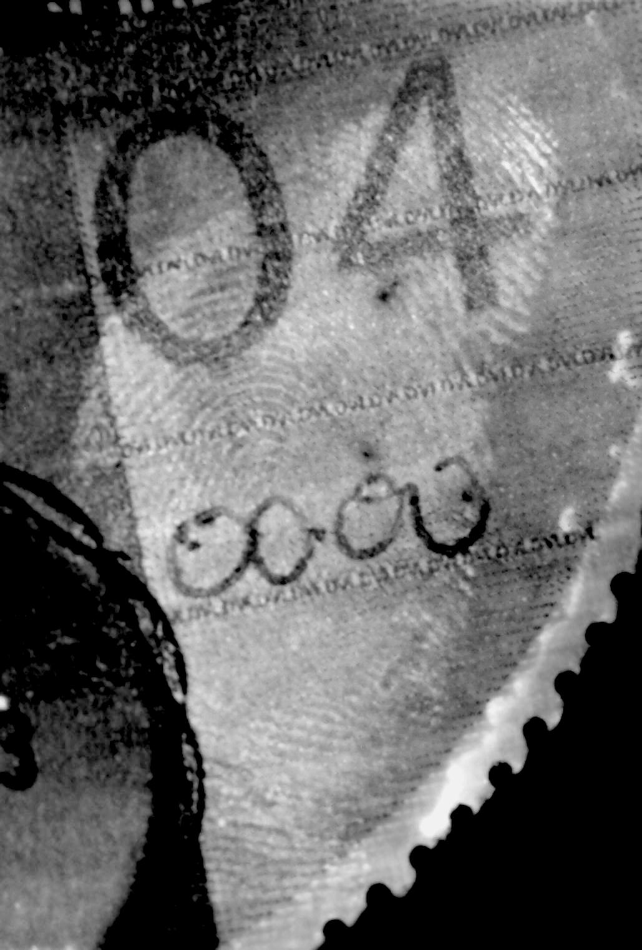
FFT

Slide 12
FFT

Slide 13
Lasers

Slide 14
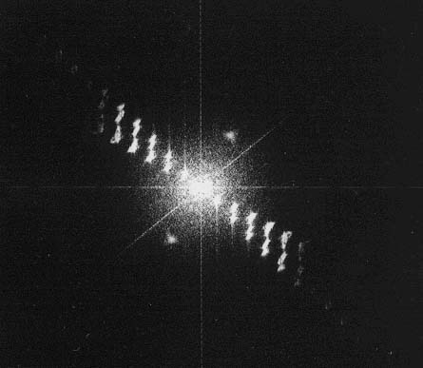
Fingerprint
Image
Back Focal
Plane
Image
F=50mm
U
V
1/V + 1/U = 1/F
s
s
f
S = fQλ

Slide 15
A Sinusoidal grating diffracts a normally incident laser beam in such a way as to produce three output beams. One of these beams travels in the same direction as the incident beam. The other two beams are diffracted through angles of +θ and -θ respectively, where θ must satisfy the equation d sin θ = λ.
S = fQλ
S = Separation of the spots
f = Focal Length
q = Spatial frequency
λ = wavelength
s
s
f

Slide 16
Addition theorem
The Addition Theorem states that if a component is added to or removed from the x space representation of a profile, then it’s Fourier transform is added to, removed from, the spatial frequency spectrum of the profile.
If any two wavelengths of light have the same wavelength they will superimpose upon each other to increase their relative amplitude. They will eventually appear as an exceptionally bright spot in the diffraction pattern. These bright spots are commonly referred to as frequency spikes.
+
=

Slide 17
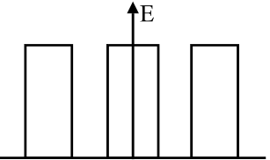
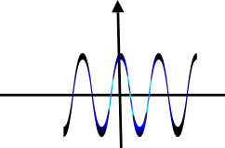
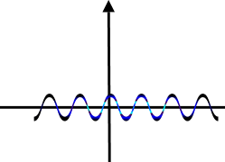
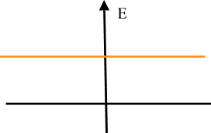
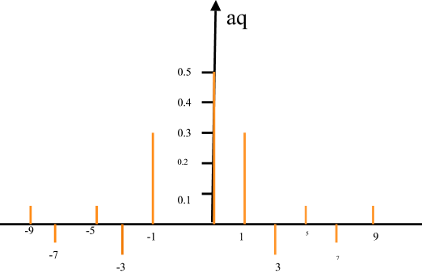
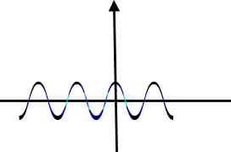
Sum of sine waves = square wave
Square wave Spatial/Visible domain
+
=
+
FFT/Frequency domain

Slide 18
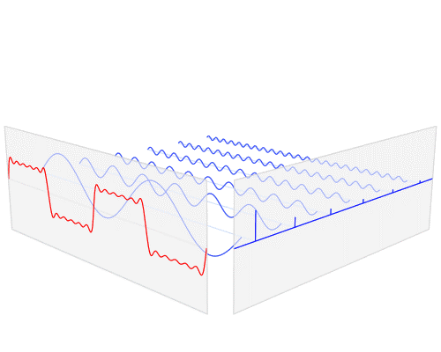
sum of six sine functions (in red) of different amplitudes and harmonically related frequencies. The summation is the Fourier series. FFT(in blue) depicts amplitude v frequency

Slide 19

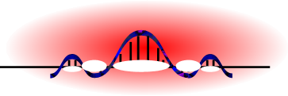
Images with many wavelengths
The Sinc Function
FFT of the square wave
Spot separation
S = fqλ
Diffraction pattern

Slide 20
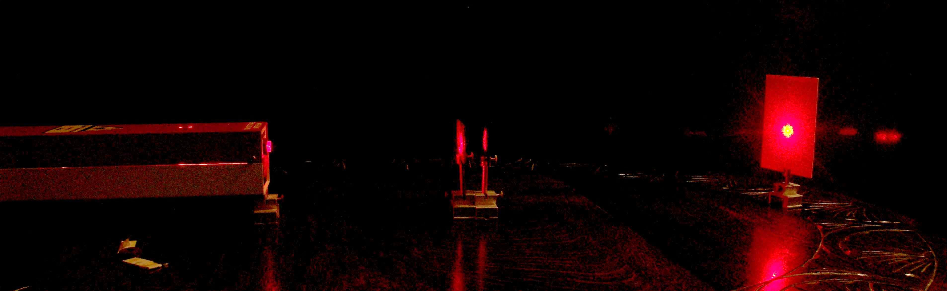
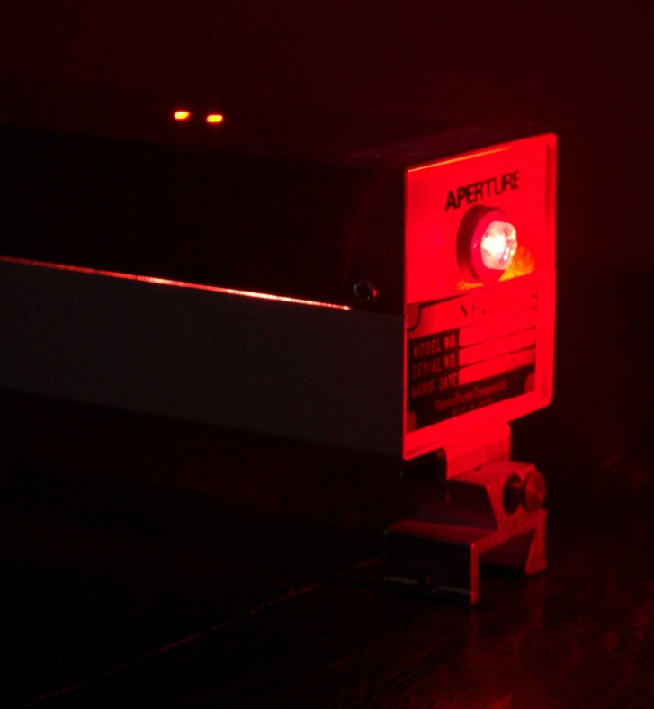
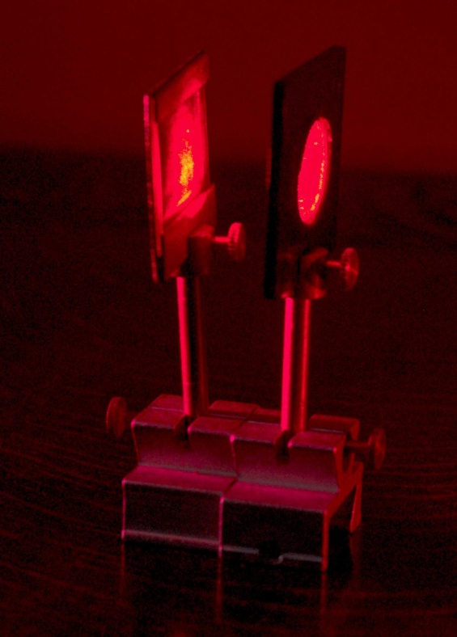
F=500mm
Back Focal Plain
Object Lens

Slide 21
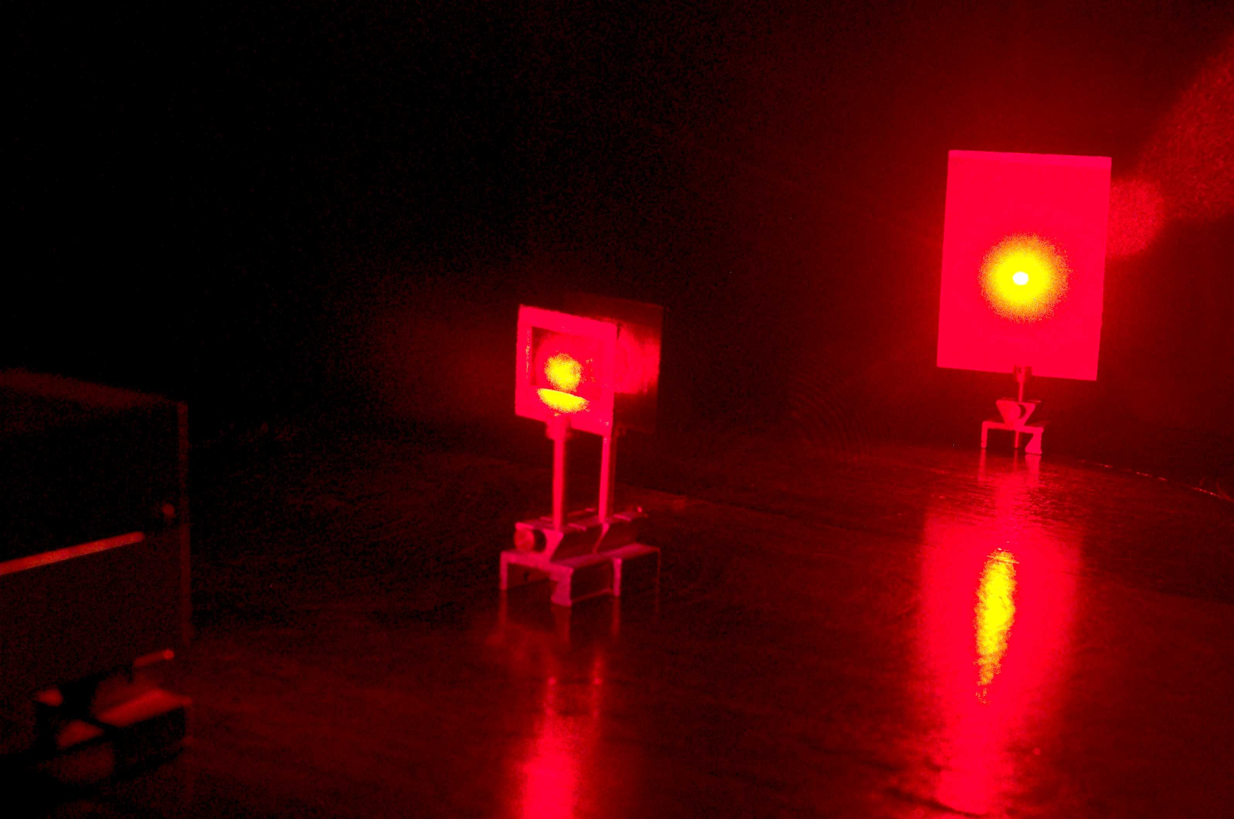
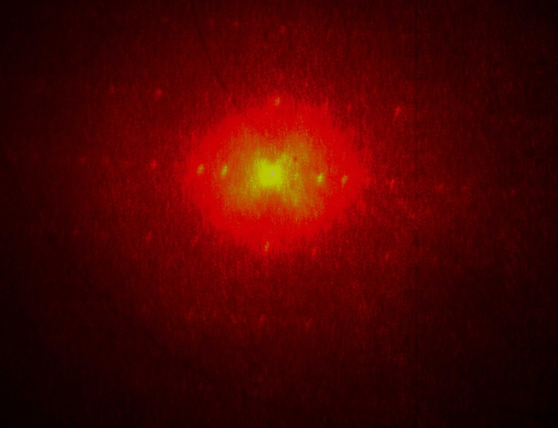
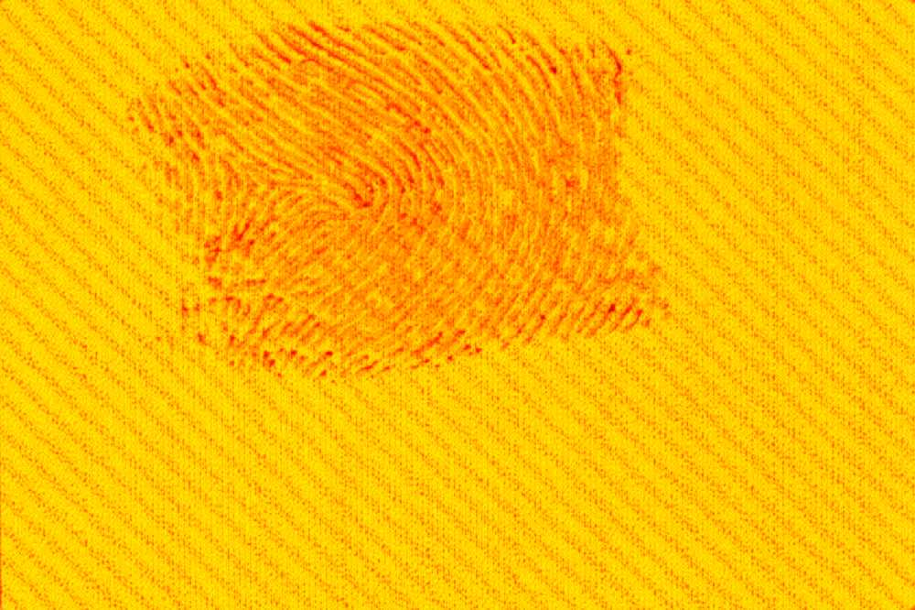

Slide 22
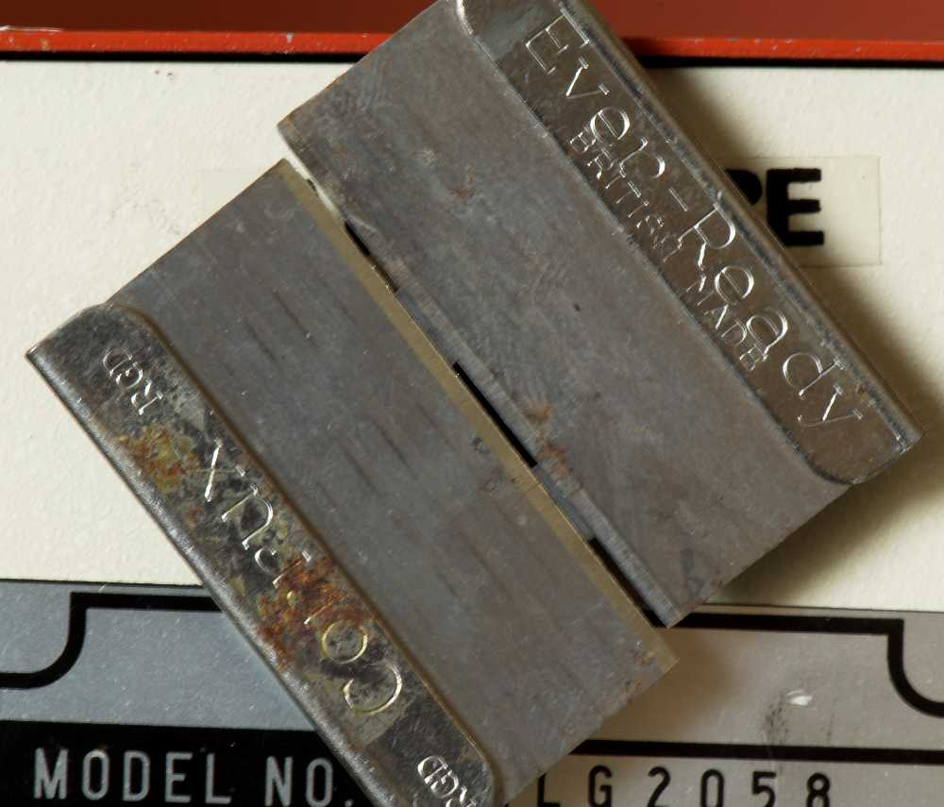
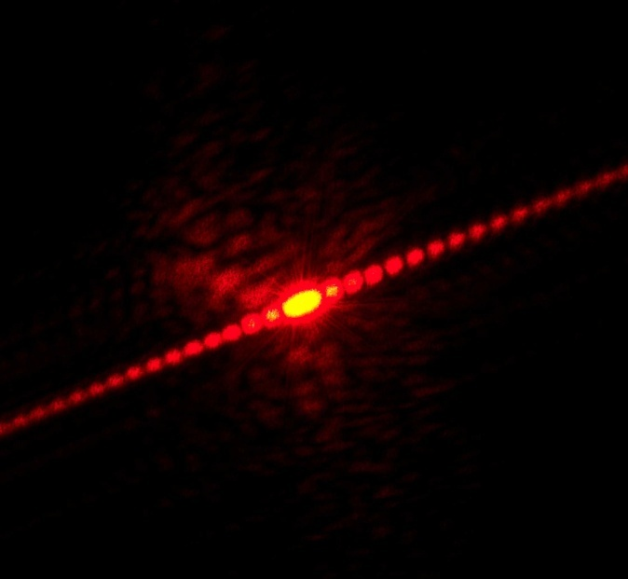
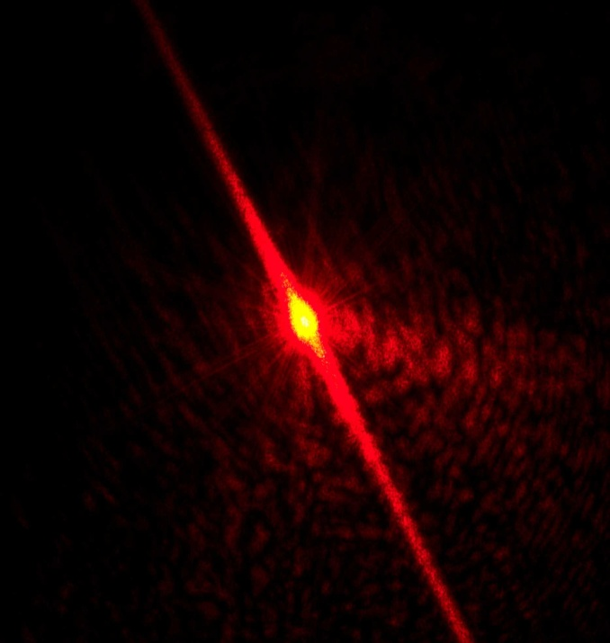
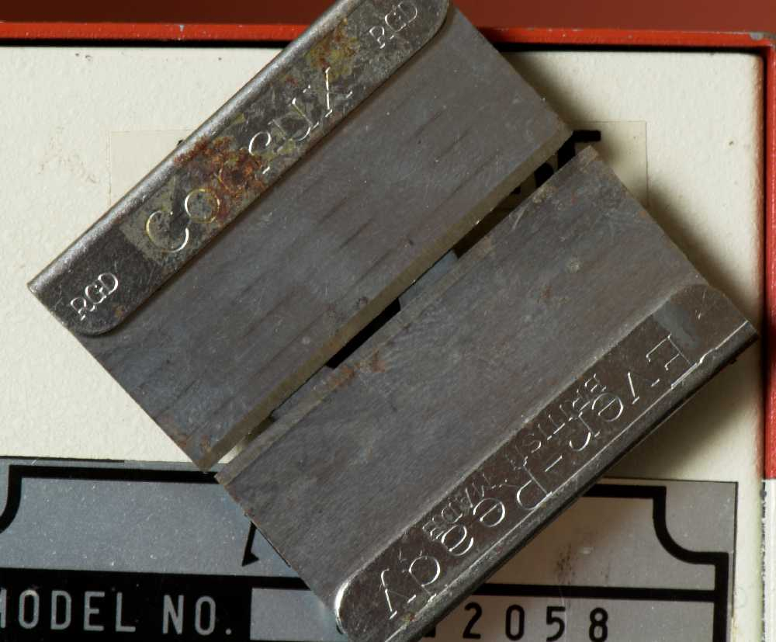
Fft wavelength
orientation

Slide 23
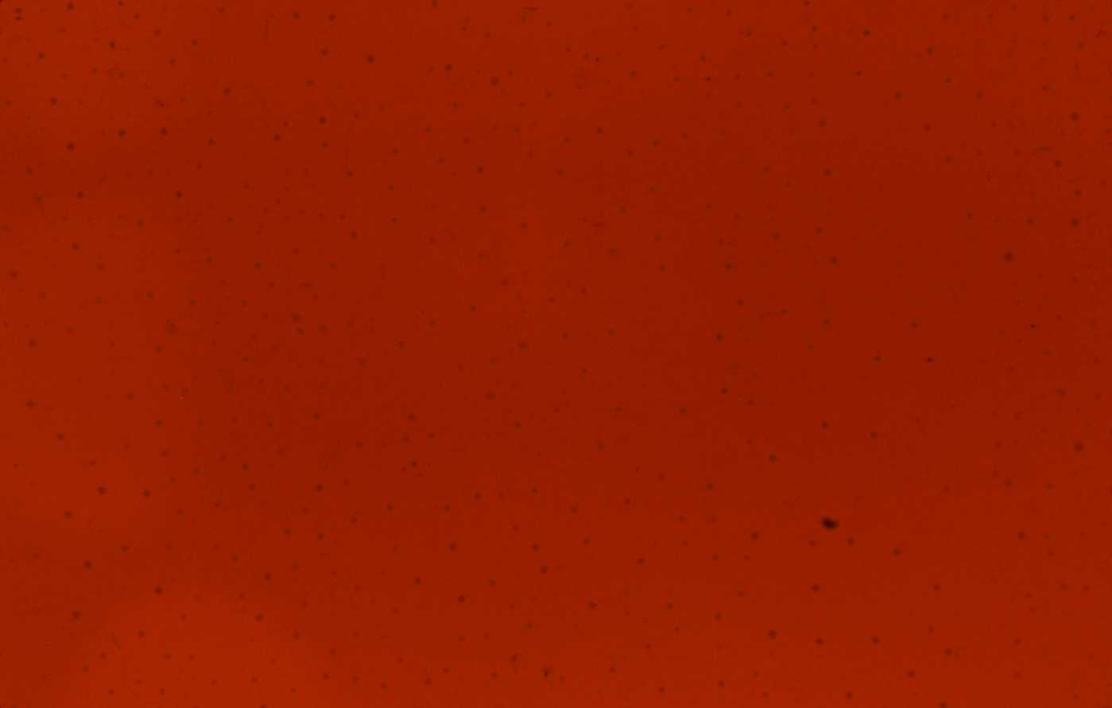
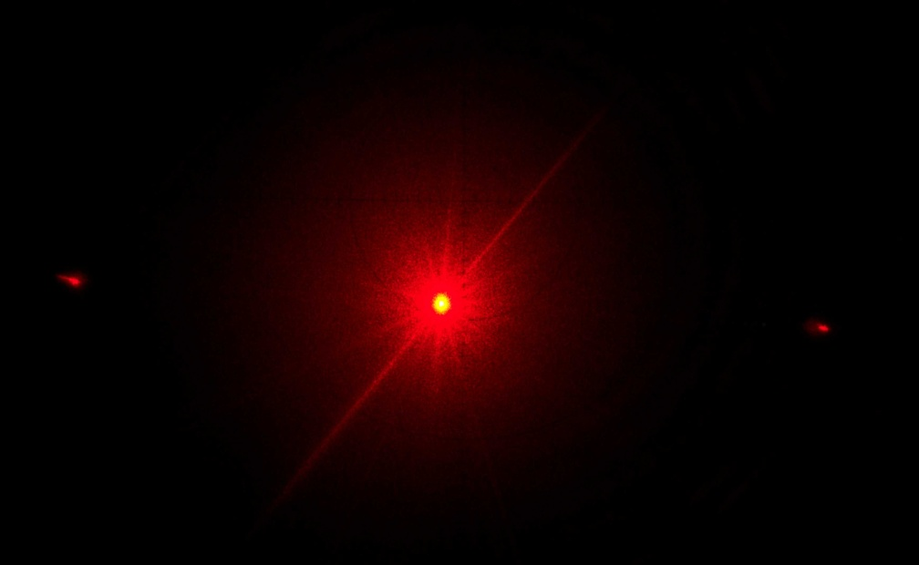
Frequency Repetition
300 lines per mm
Small number of frequency spikes

Slide 24
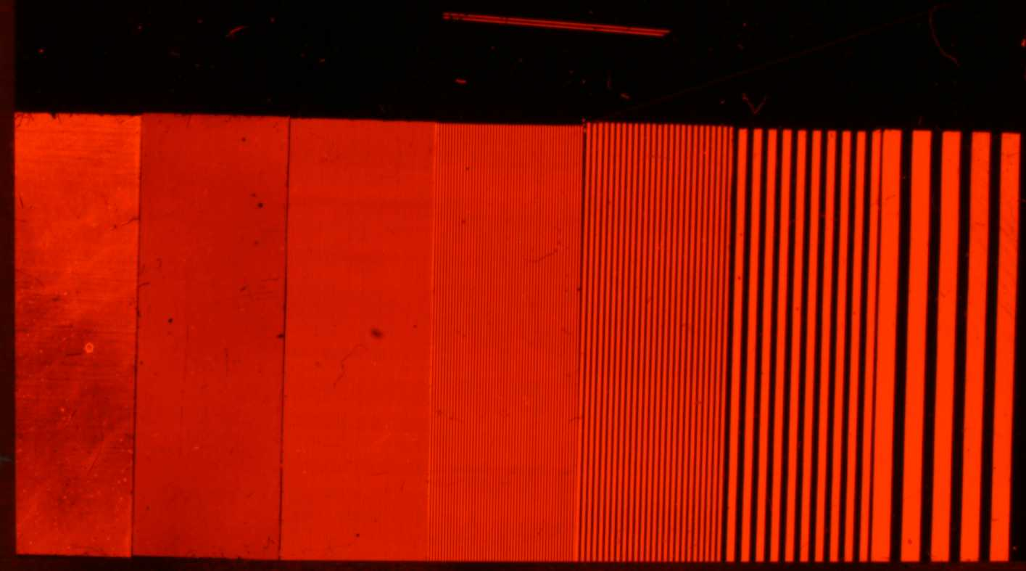
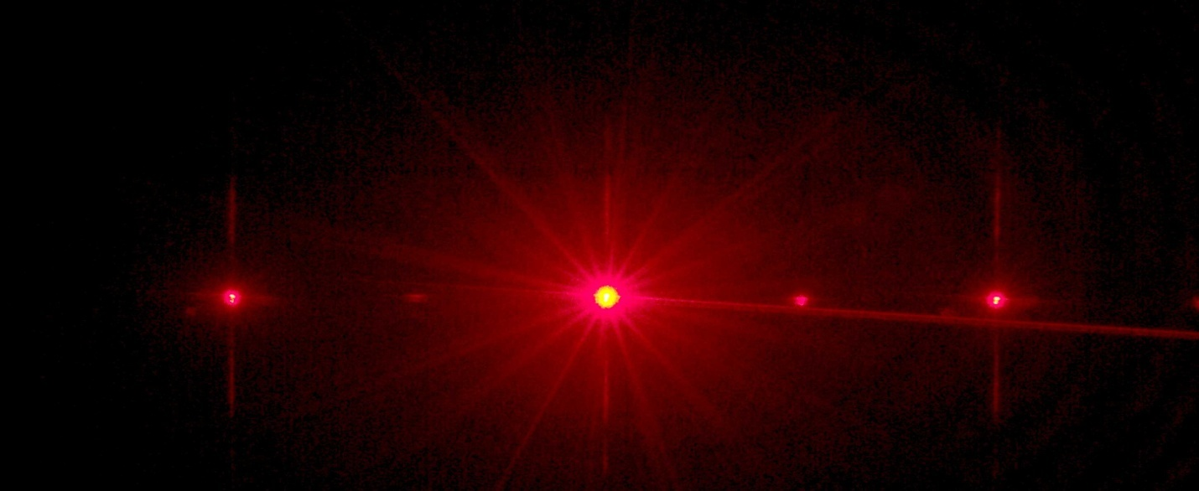
Frequency Repetition

Slide 25
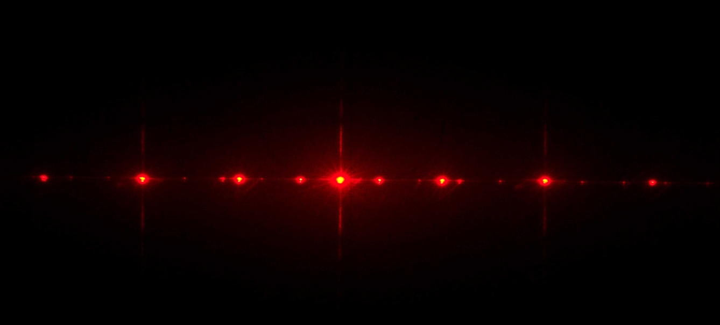
Frequency Repetition

Slide 26
Frequency Repetition

Slide 27
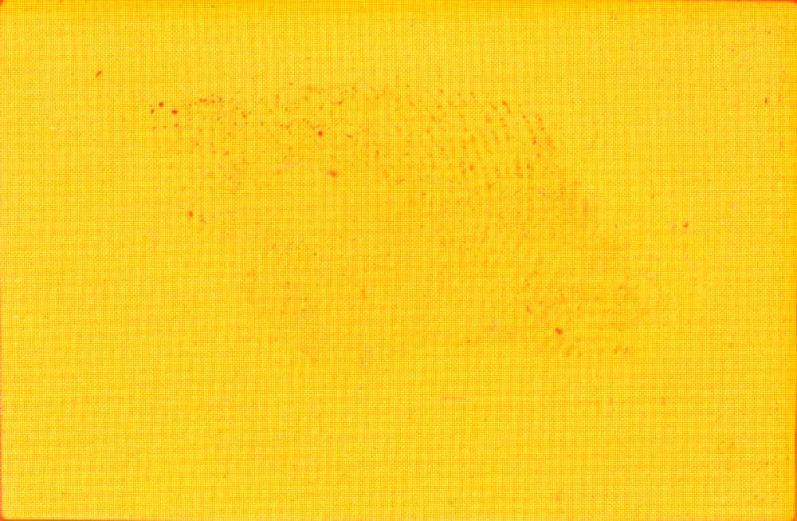
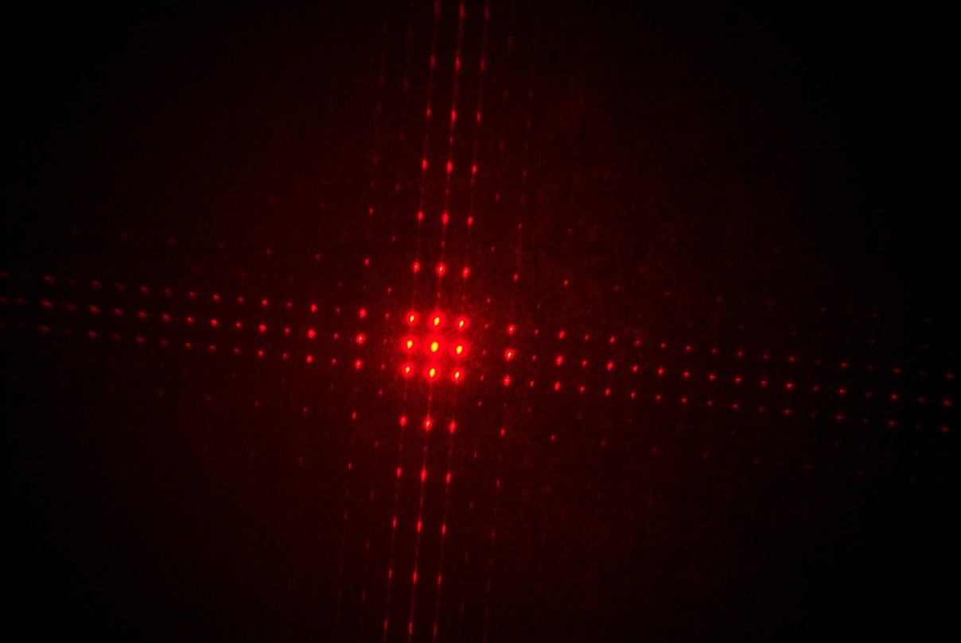
Frequency Repetition
Fabric

Slide 28

Fourier transform
for pattern removal
Regular repetitive patterns show as frequency spikes
Every time you photograph an image the orientation changes the ‘mirrored’ position of the frequency spikes.
The more complicated/fine the pattern the fewer the frequency spikes
Every white dot is a wavelength of light

Slide 29
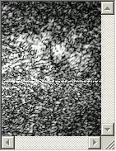
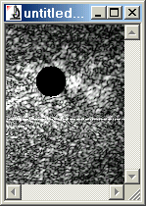
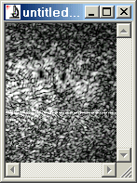
FFT Filters
Pattern Removal – Hanning and Rectangle filter
Original
Rectangle
Hanning

Slide 30
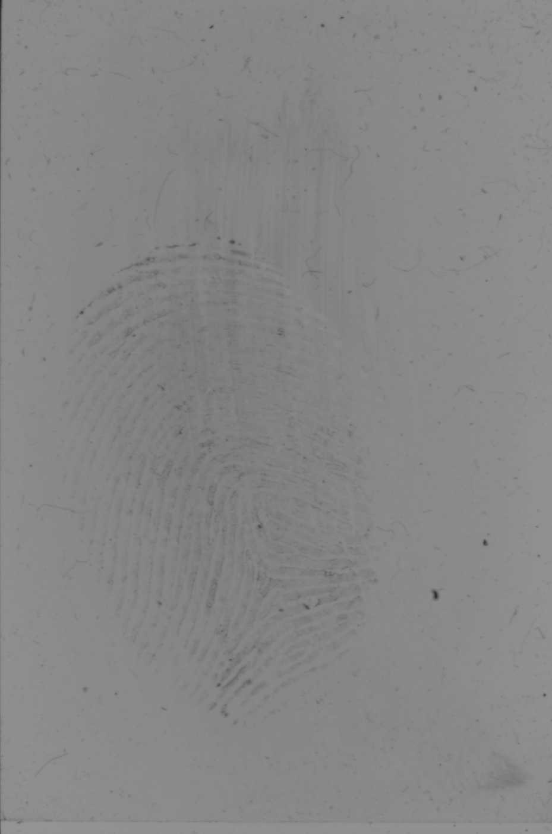
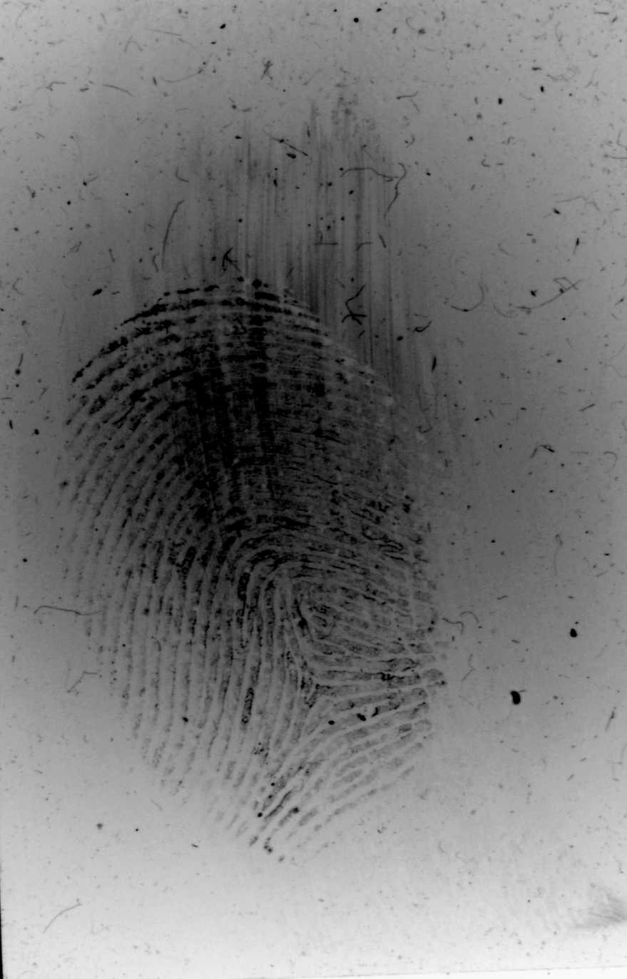
Application of fft
Image
Amplification

Slide 31
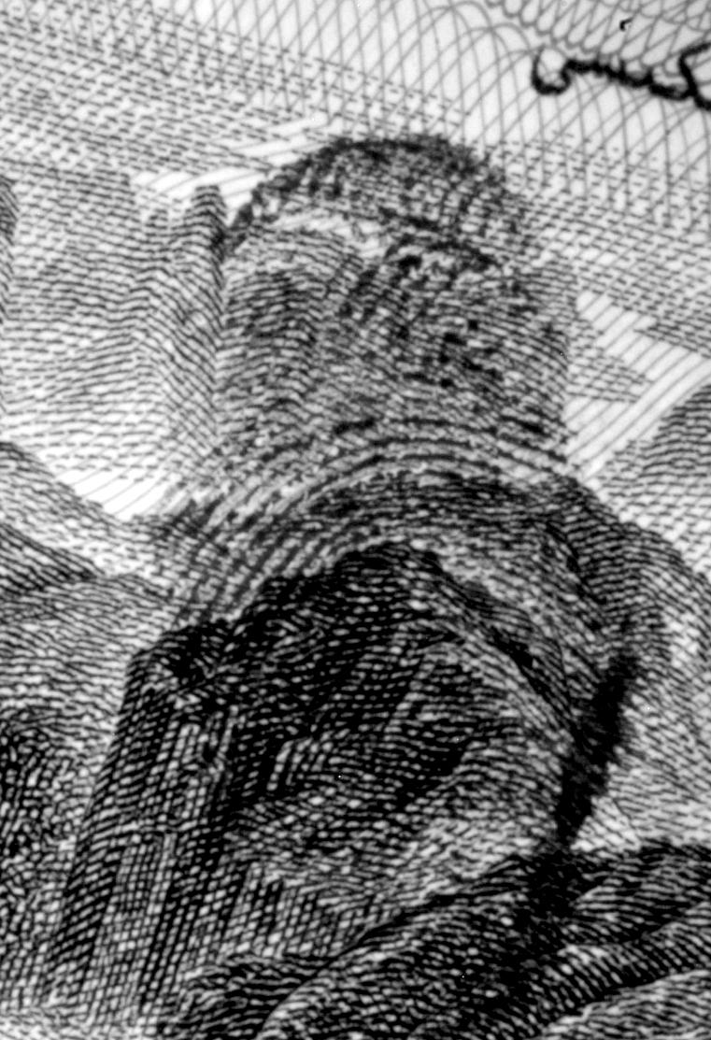
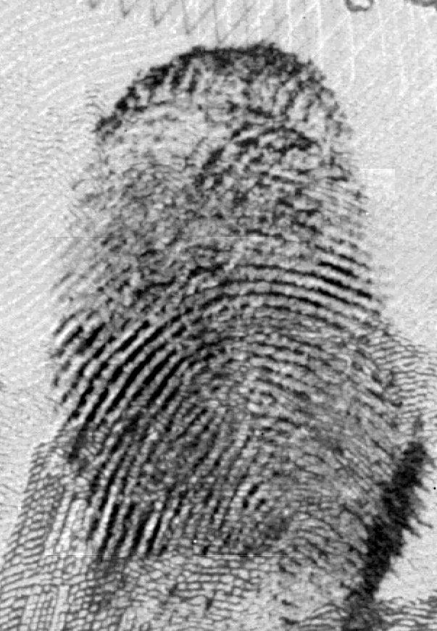
Application of fft
Boost

Slide 32
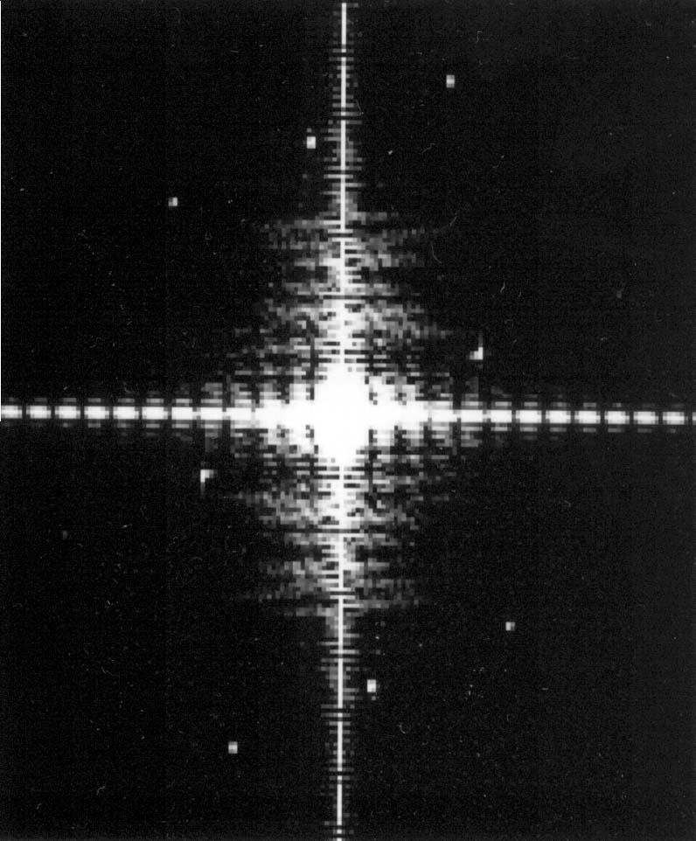
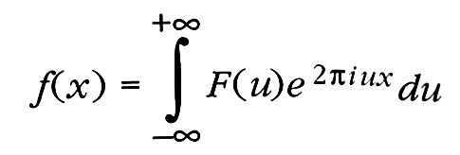
Computing the fft

Slide 33
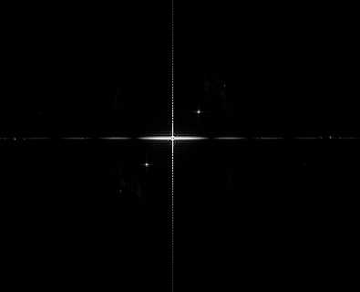
Image class
1
24
15
5
35
1
28
50
9
95
5
99
8-bit - 256 greyscale 0-255

Slide 34
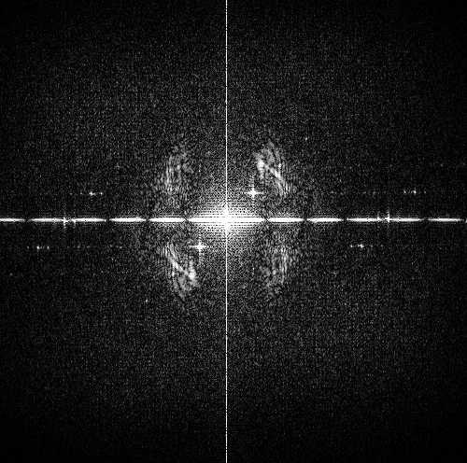
Image class
1
24
15
5
35
1
28
50
9
95
5
99
8-bit - 256 greyscale 0-255
12-bit – 4096 greyscale 0-4095
16-bit contains values from 0-65,536

Slide 35
Image class
1
24
15
5
35
1
28
50
9
95
5
99
12-bit images give optimal FFT results

Slide 36
Spike removal
Every white dot is a wavelength of light
Remove too much
Remove too little
Distortion of the image
Ineffective pattern removal
Most common problems
With auto pattern removal
Blurs ridge detail

Slide 37
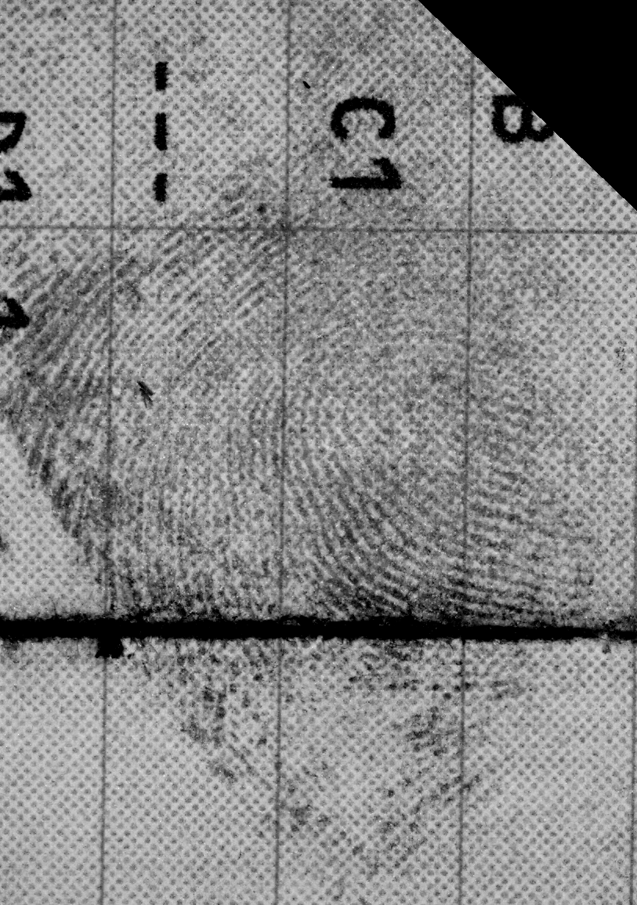
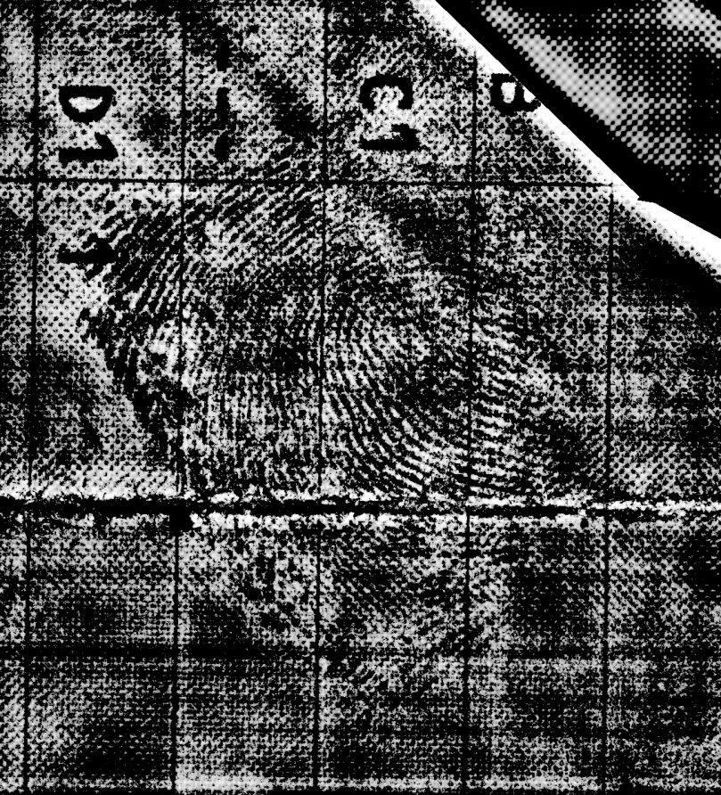
Original image
With fine dots and lines.
Auto Enhanced FFT – Removed too much

Slide 38
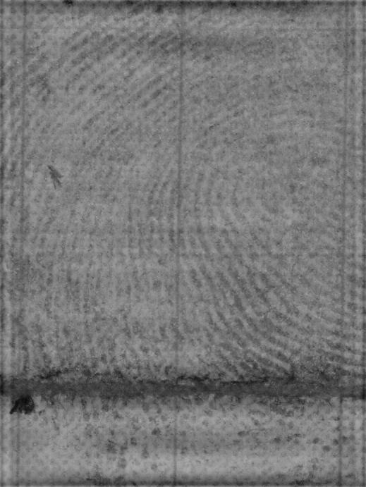
Original image
With fine dots and lines.
Remove some background image distortion

Slide 39
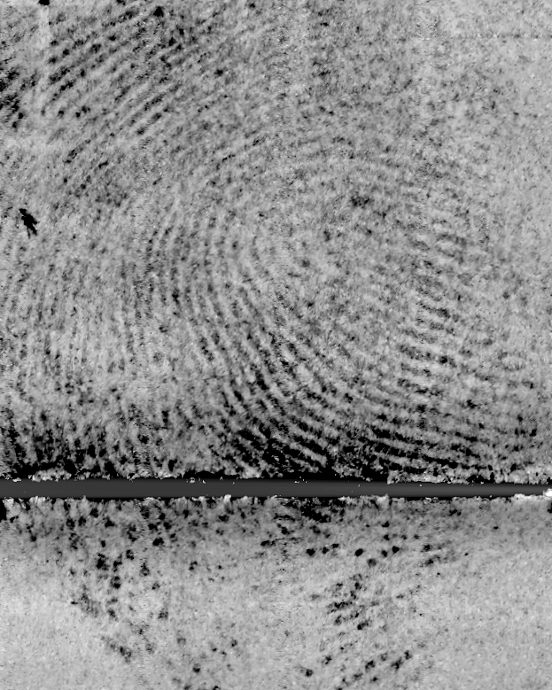
Original image
With fine dots and lines.
Enhanced Image

Slide 40
✖
✖
✔
Enhanced Image

Slide 41
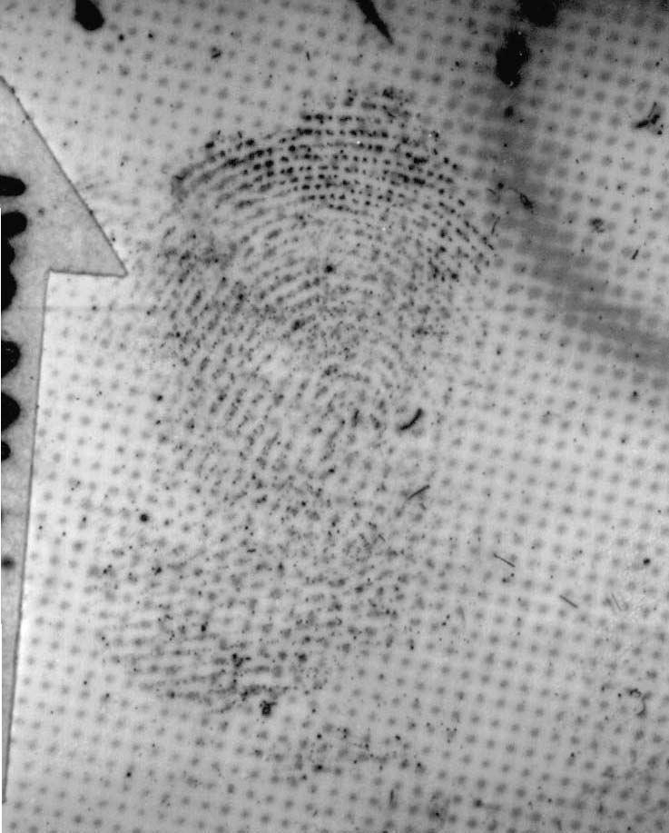

STICKY TAPE

Slide 42
STICKY TAPE
Diffraction pattern of spots on tape

Slide 43


BANK NOTES

Slide 44

BANK NOTE
Diffraction pattern from bank note

Slide 45


NINHYDRIN

Slide 46

NINHYDRIN
Diffraction pattern from Ninhydrin on newspaper

Slide 47


SHINY CARDBOARD
Original
After FFT and AOI

Slide 48

SHINY CARDBOARD
Diffraction Pattern

Slide 49


FLUORESCENCE
Original
After FFT

Slide 50

FLUORESCENCE
Diffraction Pattern

Slide 51


MULTIPLE PATTERNS

Slide 52

MULTIPLE PATTERNS

Slide 53
FFT IN FINGERPRINTS
FFT used as follows
Remove regular background patterns
Amplify faint ridge detail &
low contrast images
Increase clarity of individual ridges
Separate overlaid fingerprint ridges

Slide 54



Slide 55


Slide 56




Slide 57


Slide 58
6
2
5
1
3
4

Slide 60





Crime-lite Blue Light

Slide 61


Separate ridges
Original
Underneath

Slide 62
foster+freeman
Improving the Quality of Forensic Evidence
Recognised for innovation in the field of fingerprint detection & enhancement...

